Slide 1
Open Access to Scholarly Articles:
Good Policies Ensure Good Practices
Jill Cirasella
The Graduate Center, CUNY
jcirasella@gc.cuny.edu

Slide 2
Open Access: From Idea to Reality
Open access (OA) to scholarly journal articles
is now widely accepted as a good thing
However, OA will not become the norm without
institutional policies that promote openness
Why?
Because researchers are extremely busy and
publisher policies are extremely confusing

Slide 3
Personal Pledges
Completely personal — applies to the individual only
Up to the individual to adhere, enforce
Do not have much influence on their own
However, many people acting individually can have influence — by being ambassadors for OA, by together making many works OA, and by communicating to publishers the terms they want/require

Slide 4
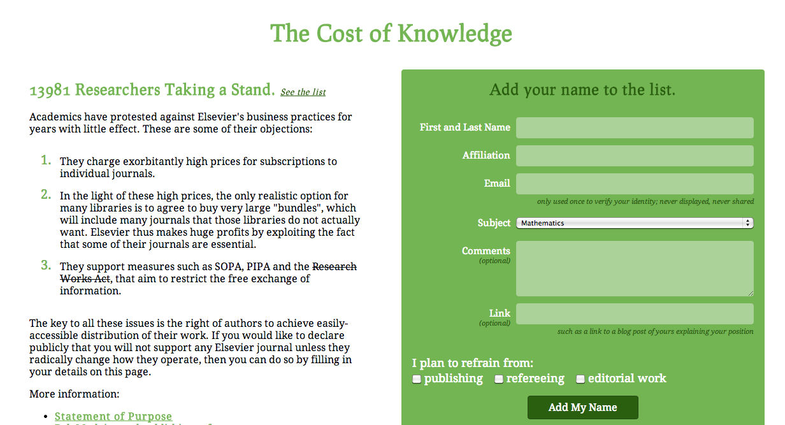
E.g., Cost of Knowledge

Slide 5
Statements, Resolutions
A body coming together to articulate their support for OA and/or specify preferred or expected behaviors
Not policies: voluntary, non-binding, non-enforceable

Slide 6
E.g., Brooklyn College Library
The Brooklyn College Library Department affirms that open access to scholarship is critical for scholarly communication, affordable education, and the advancement of knowledge. Accordingly, the Department asks its faculty to make their research available at no cost whenever possible by seeking publishers that have adopted open access policies (i.e., publishers that publish their contents online without restriction and/or allow authors to self-archive their publications in online repositories). Whenever self-archiving is allowed, the Department expects its faculty to promptly self-archive their publications online for all to read and use. When faculty are working with publishers that do not allow self-archiving, the Department encourages them to negotiate to improve publication agreements. Furthermore, the Department encourages its faculty to devote most of their reviewing and editing efforts to manuscripts destined for open access.

Slide 7
E.g., Brooklyn College Library
The Brooklyn College Library Department affirms that…
Accordingly, the Department asks its faculty to…
…the Department expects its faculty to…
…the Department encourages them to…
Furthermore, the Department encourages its faculty to…

Slide 8
Opt-In Policies
A body coming together to articulate their support for OA and/or specify preferred or expected behaviors
Although called “policies,” they are essentially the same as statements/resolutions: voluntary, non-binding, non-enforceable

Slide 9
E.g., Mount Saint Vincent U
Mount Saint Vincent University is committed to disseminating its research and scholarship as widely as possible. This policy outlines the principle of open access and provides guidelines for voluntary support of the principle by members of the Mount community.
The Mount requests that faculty, academic and professional staff members deposit in the Mount's Digital Commons an electronic copy of any research article which has been accepted for publication. The contract with the publisher determines whether the article may be deposited as a pre-print or post-print, restricted in some way (listed in the repository as a record of the Mount's research but is not accessible online by other researchers) or completely accessible online by researchers as an open access document.

Slide 10
E.g., Mount Saint Vincent U
This policy outlines the principle of open access and provides guidelines for voluntary support…
The Mount requests that…
…Mount faculty and staff are encouraged to…

Slide 11
Opt-Out Policies
A body authorizing a new normal: A policy that is in effect by default and automatically applies to all scholarly journal articles produced by that body
Generally: Researchers automatically grant the institution a non-exclusive license to their scholarly articles, so that the articles may be made OA in the institution’s repository
Because they are automatic/mandatory, these policies are sometimes called “mandates,” but “mandate” is too scary a word — these policies allow faculty to opt out and do not compromise academic freedom

Slide 12
E.g., Harvard
…the Faculty adopts the following policy: Each Faculty member grants to the President and Fellows of Harvard College permission to make available his or her scholarly articles and to exercise the copyright in those articles. In legal terms, the permission granted by each Faculty member is a nonexclusive, irrevocable, paid-up, worldwide license to exercise any and all rights under copyright relating to each of his or her scholarly articles, in any medium, and to authorize others to do the same, provided that the articles are not sold for a profit. The policy will apply to all scholarly articles written while the person is a member of the Faculty except for any articles completed before the adoption of this policy and any articles for which the Faculty member entered into an incompatible licensing or assignment agreement before the adoption of this policy. The Dean or the Dean’s designate will waive application of the policy for a particular article upon written request by a Faculty member explaining the need.

Slide 13
E.g., Harvard
Each Faculty member grants to the President and Fellows of Harvard College permission to…
In legal terms, the permission granted by each Faculty member is a nonexclusive, irrevocable, paid-up, worldwide license…
The policy will apply to all scholarly articles…
The Dean or the Dean’s designate will waive application of the policy for a particular article…

Slide 14
Policies Tied to Tenure/Promotion
Policies that specify how openness should factor into the decisions of tenure & promotion committees
Policies that dictate how materials must be submitted by applicants for tenure, promotion, institutional grants, etc.

Slide 15
E.g., Virginia Commonwealth U
Whereas…
Whereas…
Whereas…
Therefore, the Faculty Senate of Virginia Commonwealth University recommends: VCU promotion and tenure committees should recognize that publication and editorial effort in open access, peer-reviewed journals or re-publication of peer-reviewed articles in an open access repository offers added value and greater public good than scholarship made only available in expensive journal publications.

Slide 16
E.g., Virginia Commonwealth U
Therefore, the Faculty Senate of Virginia Commonwealth University recommends:
VCU promotion and tenure committees should recognize that…

Slide 17
E.g., University of Liège
…it is incumbent upon each ULg member to feed ORBi with his/her own references. In this respect, the Administrative Board of the University has decided to make it mandatory for all ULg members:
to deposit the bibliographic references of ALL their publications since 2002;
to deposit the full text of ALL their articles published in periodicals since 2002.
Access to these full texts will only be granted with the author's consent and according to the rules applicable to author's rights and copyrights.
…only those references introduced in ORBi will be taken into consideration as the official list of publications accompanying any curriculum vitae for all evaluation procedures ‘in house’ (designations, promotions, grant applications, etc.).

Slide 18
E.g., University of Liège
…the Administrative Board of the University has decided to make it mandatory…
…only those references introduced in ORBi will be taken into consideration as the official list of publications accompanying any curriculum vitae for all evaluation procedures ‘in house’ (designations, promotions, grant applications, etc.).

Slide 19
Explore More Policies: ROARMAP
Registry of Open Access Repositories
Mandatory Archiving Policies
http://roarmap.eprints.org/

Slide 20
A Policy for CUNY? Ideally…
First
A well-supported, well-staffed repository
Next
A strong faculty-driven policy — with an opt-out clause
Why?
A CUNY-wide repository supported by a strong policy
is critical to fulfilling CUNY’s mission to provide
“high-quality, accessible education.”
(Also good for the CUNY’s visibility and status!)

Slide 21
PS: Agency and Government Policies
National Institutes of Health
Articles based on NIH-funded research
must become OA within 12 months
White House Office of Science and
Technology Policy OA Directive
Massive expansion of NIH policy
NY Taxpayer Access to Publicly Funded Research
A NIH-like policy for New York State?

Slide 22
Links to Cited Policies
Cost of Knowledge: http://thecostofknowledge.com/
Brooklyn College Library Statement of Support for OA:
http://library.brooklyn.cuny.edu/resources/?page=oastatement
Mount Saint Vincent University Policy:
http://www.msvu.ca/site/media/msvu/Open%20Access%20Policy%20Library.pdf
Harvard Faculty of Arts & Sciences Open Access Policy: https://osc.hul.harvard.edu/hfaspolicy
Virginia Commonwealth U Faculty Senate Resolution on OA Publishing: http://www.facultysenate.vcu.edu/2010/11/17/vcu-faculty-senate-resolution-1/
U of Liege Open Access Policy: http://roarmap.eprints.org/56/

Slide 23
Links to Cited Policies
NIH Public Access Policy: http://publicaccess.nih.gov/
White House Office of Science and Technology Policy Open Access Memo:
http://www.whitehouse.gov/sites/default/files/microsites/ostp/ostp_public_access_memo_2013.pdf
New York Taxpayer Access to Publicly Funded Research Legislation:
http://sparc.arl.org/advocacy/state/tapfr
Photo Credit
Lion photo is © 2011 Eric Kilby, used under a Creative Commons Attribution-ShareAlike license

Slide 24
Thank you!
Questions?
Jill Cirasella
The Graduate Center, CUNY
jcirasella@gc.cuny.edu

