Slide 1
Open Access to Scholarly Literature:
Which Side Are You On?
Jill Cirasella
The Graduate Center, CUNY
jcirasella@gc.cuny.edu

Slide 2
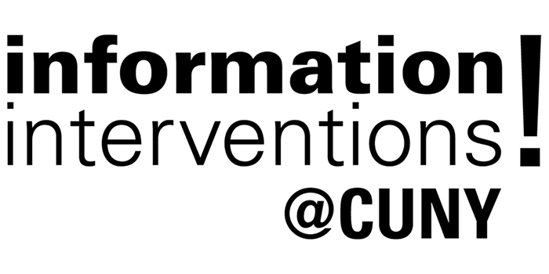
Co-Sponsors for Information Intervention #1
LACUNY Scholarly Communications Roundtable
Just Publics @ 365
Upcoming Information Interventions:
Predatory Publishers & Conferences (11/15)
Open Educational Resources (Spring)
Open Access and Dissertations (Spring)

Slide 3
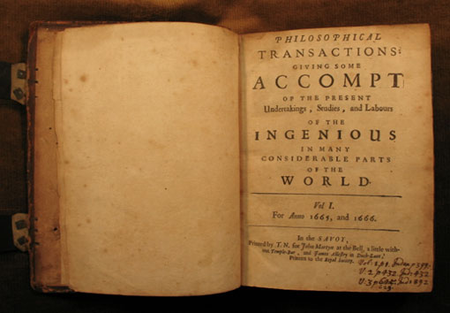
Scholarly Publishing Then

Slide 4
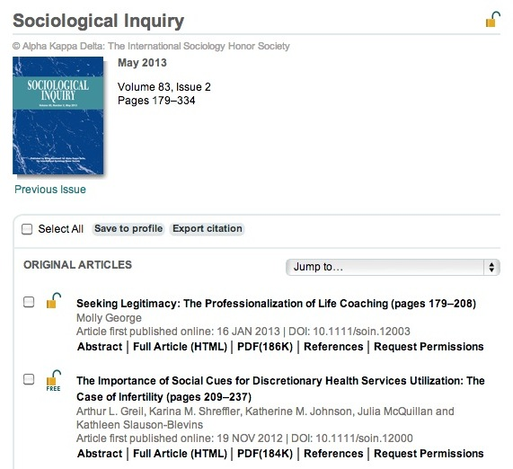
Scholarly Publishing Now

Slide 5
What was once difficult and costly
is now easy and inexpensive.
Do journal prices reflect this?
For the most part, no!

Slide 6
The traditional system
of scholarly communication
is outmoded, expensive,
and suboptimal.
And exploitative, too!

Slide 7
Sound Familiar?
Scientist Meets Publisher
http://youtu.be/GMIY_4t-DR0

Slide 8
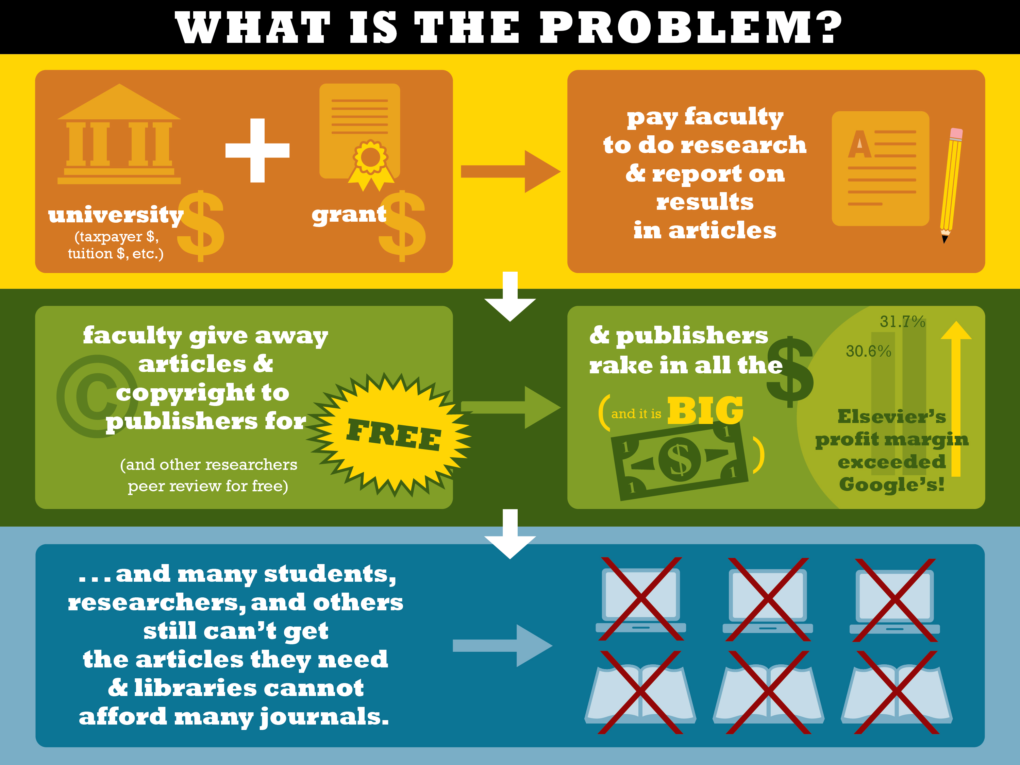

Slide 9
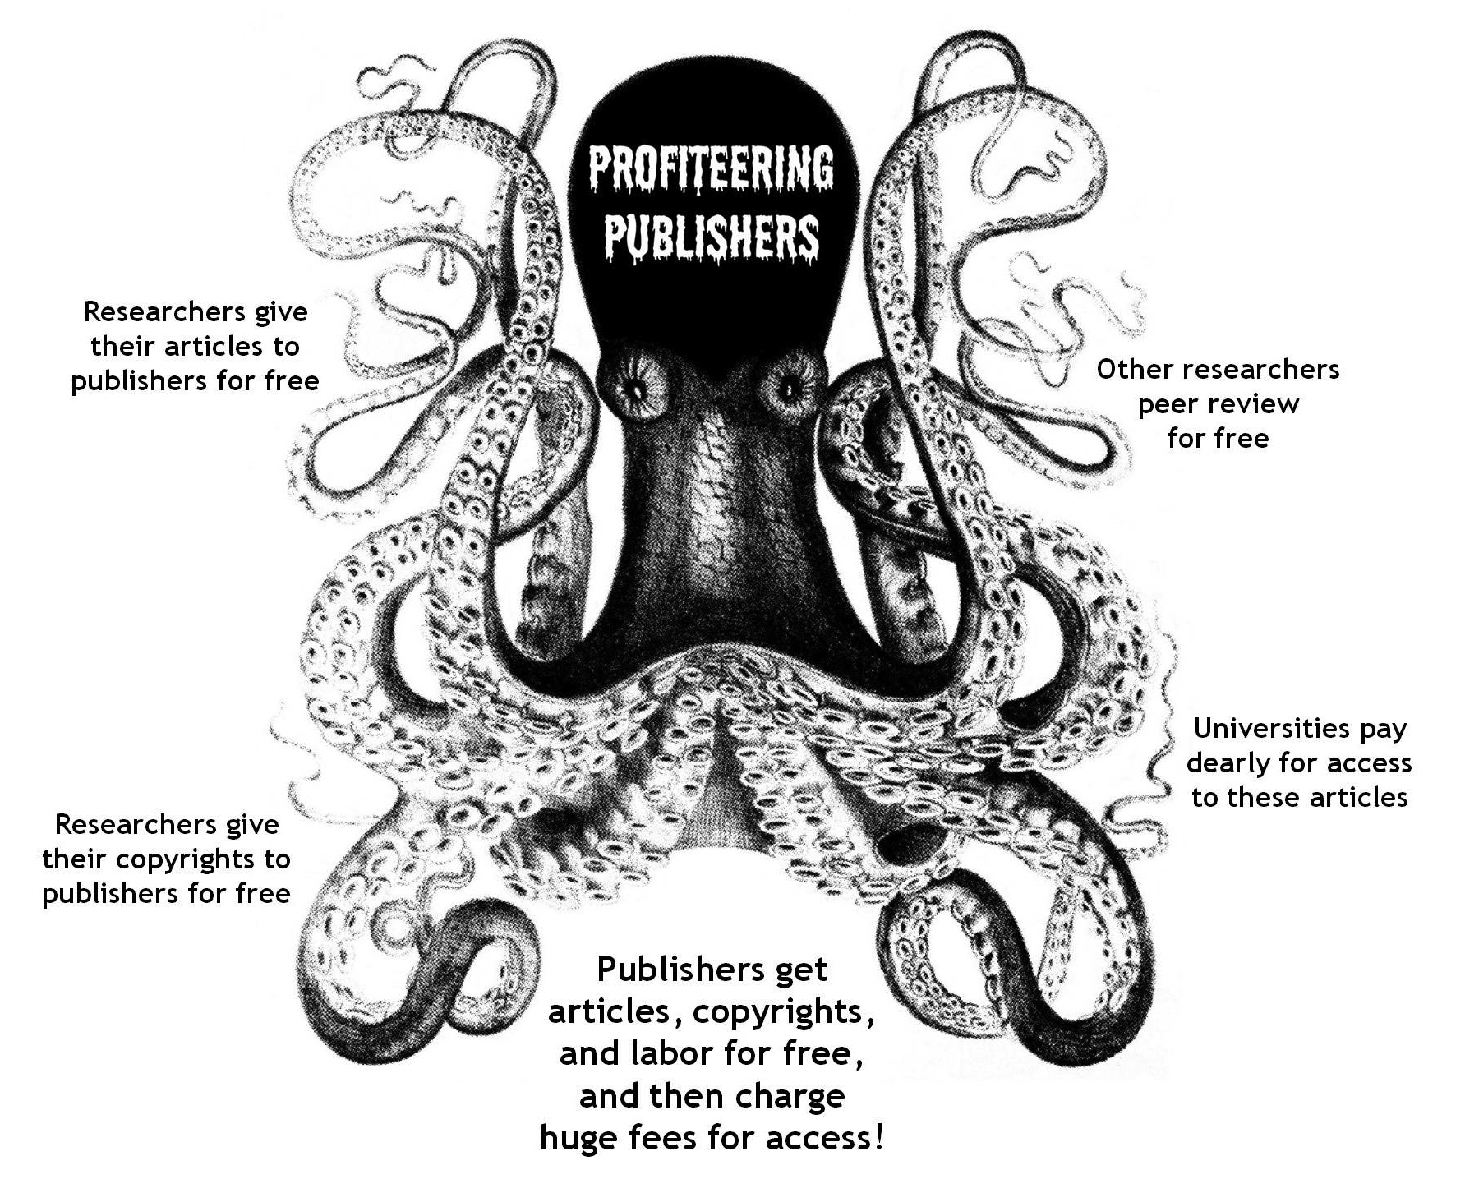

Slide 10
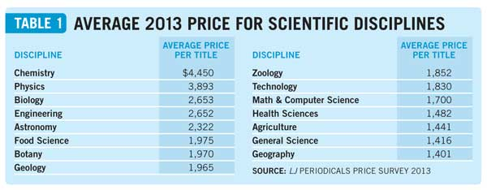
Journal Publishing is BIG Business
Source: Bosch, Stephen, and Kittie Henderson. "The Winds Of Change: Periodicals Price Survey 2013." Library Journal 21 July 2013. http://lj.libraryjournal.com/2013/04/publishing/the-winds-of-change-periodicals-price-survey-2013

Slide 11
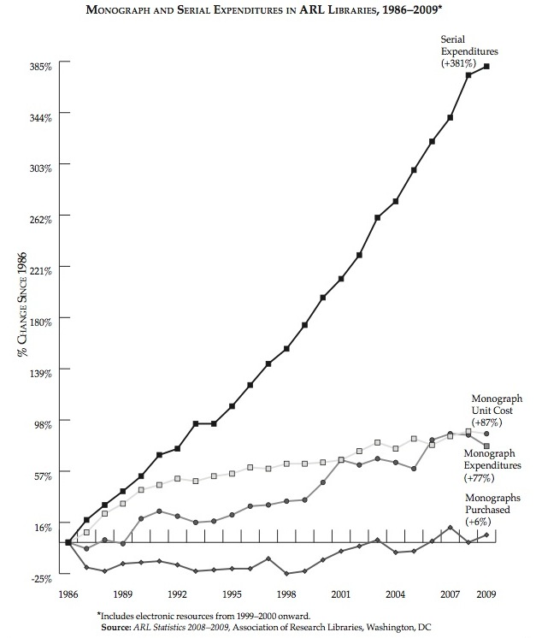
Journal Subscriptions are BIG Costs
Journal prices are increasing at an alarming rate, straining academic library budgets.
From 1986 to 2009, serial expenditures at research libraries increased 381%.
(Book expenditures rose only 77% in the same period.)

Slide 12
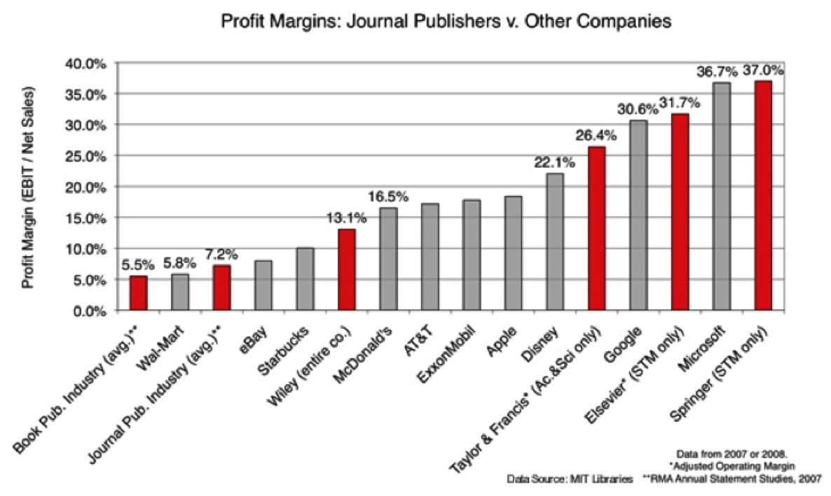
“I Like to Buy Houses on the Beach”
Up to 38% in 2012!

Slide 13
Despite Noble-Sounding Claims…
“Elsevier disseminates and preserves STM literature to meet the information needs of the world’s present and future scientists and clinicians — linking thinkers with ideas.”
from Elsevier’s Mission Statement
http://www.elsevier.com/about/mission

Slide 14
Despite Noble-Sounding Claims…
“Elsevier disseminates and preserves STM literature to meet the information needs of the world’s present and future scientists and clinicians — linking thinkers with ideas.”
from Elsevier’s Mission Statement
http://www.elsevier.com/about/mission
Bullsh*t!

Slide 15
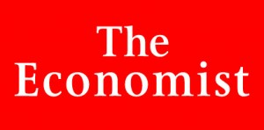
Don’t Take My Word for It!
“Publishing obscure academic journals is
that rare thing in the media industry:
a licence to print money.”
Source: "Open sesame: Academic publishing." The Economist 14 Apr. 2012.
http://www.economist.com/node/21552574

Slide 16
What Is the Solution?
Open access to
scholarly journal articles
and other scholarly materials!

Slide 17
What Is Open Access?
Open access (OA) materials are:
accessible at no cost on a journal website or in a repository committed to long-term archiving
available for all to read, download, print, copy, share, etc. (attribution always required, of course)
Many kinds of documents can be made OA: journal articles, textbooks and other kinds of books, data sets, dissertations, instructional modules, conference presentations, and much more.

Slide 18
How to Achieve OA: Go Gold
Gold Open Access
“Gold OA” means publishing with publishers
that automatically and immediately make
the work available online to all at no cost.
Most gold OA publishers are journal publishers,
but a few book publishers make their books OA.
More about gold OA later…

Slide 19
How to Achieve OA: Go Green
Green Open Access
“Green OA” refers to works that,
regardless of where else they appear,
are made available online in an OA repository
committed to long-term preservation.
Journals are called “green” if they permit authors
to self-archive their articles in OA repositories.
Most journals do allow self-archiving,
but most authors don’t know that!
More about green OA later…

Slide 20
Finding OA Materials
OA materials are available at no cost online, either on an OA journal site or in some kind of OA repository.
Therefore, OA materials are easily findable via Google, Google Scholar, and other web search tools.
In addition, library databases index many OA journals. (Of course they do!)
Upshot: You will find OA materials naturally when you do research.

Slide 21
Who Benefits from OA?
Readers:
More content is available to everyone, regardless of
institutional affiliation or ability to pay
Students:
Students have access to the literature they need to master their fields, no matter what college/university they attend

Slide 22
Who Else Benefits?
Authors:
Increased availability
→ More readers
→ More scholarly citations, impact in the field
Easy to link to
→ More mentions/links in news, blogs, etc.
→ Broader awareness in the world
Greater control over own work
→ No need to relinquish copyright to publishers
→ Publishers don't dictate copying, sharing, etc.

Slide 23
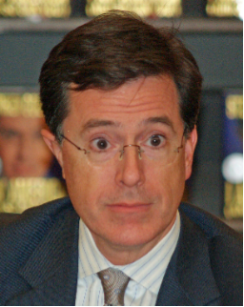
The Colbert Bump
“the curious phenomenon whereby
anyone who appears on this program
gets a huge boost in popularity”
— Stephen Colbert
Colbert Report, 6/21/07
Photo by David Shankbone

Slide 24
The Open Access Bump
Similarly, open access boosts the impact of articles:
easier to access → read more → cited more
It makes intuitive sense, but it’s also been proven.
Lawrence, S. (2001). Free online availability substantially increases a paper's impact. Nature, 411(6837), 521.
Harnad, S. and Brody, T. (2004). Comparing the Impact of Open Access (OA) vs. Non-OA Articles in the Same Journals. D-Lib Magazine, 10(6).
Annotated bibliography of articles on the OA advantage:
http://opcit.eprints.org/oacitation-biblio.html

Slide 25
My OA Advantage
All of my recent works are OA. What’s happened as a result?
More readers (stats from repository)
More sharing (blog posts, tweets)
More publicity (Library Link of the Day, etc.)
Inclusion in course syllabi
Emails from readers
Invitations to write, talk
Satisfaction of having my work read & appreciated
Without a doubt: This is all because the articles are OA.

Slide 26
What Benefits from OA?
Libraries:
As OA become increasingly prevalent, libraries will be no longer be hamstrung by astronomical journal prices.
Institutions:
Institutions no longer pay twice for research:
researchers’ salaries + journal subscriptions
In the case of public institutions, the tax-paying public no longer pays three times for research:
salaries + research grants + journal subscriptions

Slide 27
What Else Benefits?
Fields of Study:
Greater access to information
→ More informed research
→ Better research
Articles made OA before they appear in journal
→ Ends reliance on journal publication cycles
→ Allows others to respond more quickly
→ Speeds innovation

Slide 28
And What Else?
The Public:
Greater access to information
→ Better informed doctors, teachers, journalists, etc.
→ Better informed individuals, voters, etc.
→ Healthier, better educated people living in
a cleaner, safer, more evidence-based world

Slide 29
Put Differently…
“Closed access means people die.”
— Peter Murray-Rust, University of Cambridge
Read more at:
http://blogs.ch.cam.ac.uk/pmr/2011/10/23/ open-research-reports-what-jenny-and-i-said-and-why-i-am-angry/

Slide 30
But Publishers Say…
“Most people involved in scientific research and in need of scientific information already have access to the articles in journals through library subscriptions at their affiliated institutions.”
— Association of American Publishers
http://www.publishers.org/issues/5/8/

Slide 31
Oh, Really?
What about…
patients
high school students
college and graduate alumni
independent researchers
citizen scientists
etc.

Slide 32
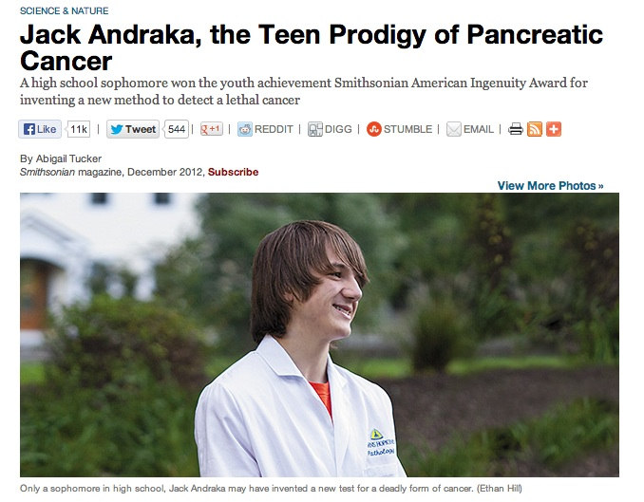
http://www.smithsonianmag.com/science-nature/
Jack-Andraka-the-Teen-Prodigy-of-Pancreatic-Cancer-179996151.html
Video: http://youtu.be/G55hlnSD1Ys

Slide 33
More about Gold OA
Reminder:
“Gold OA” means publishing with publishers
that automatically and immediately make
the work available online to all at no cost —
i.e., journals that are “born” open access

Slide 34
Respectability of Gold OA Journals?
OA = anyone can read the journal
OA ≠ anyone can publish in the journal
OA journals are real journals. Publishing in an OA journal is not self-publishing or vanity publishing!
OA journals earn respectability the same way other journals do: through the quality of their articles and the prominence of the people they attract as authors, editors, etc.
Of course: Just as some non-OA journals are better than others, some OA journals are better than others.

Slide 35
Peer Review & Gold OA Journals?
A journal's peer review practices are
independent of its openness.
Most scholarly journals,
open access and subscription-based,
are peer reviewed.
(Some open access journals are not peer reviewed;
some subscription-based journals are not peer reviewed.)

Slide 36
Impact of OA Journals?
Many OA journals are highly respected; some have very high impact factors (according to Journal Citation Reports).
Some OA journals with high impact factors:
PLoS One
PLoS Biology
BMC Evolutionary Biology
Atmospheric Chemistry and Physics
and many more…
Of course, impact factor is not equally relevant to all disciplines, and there are also other measures of importance and influence (altmetrics).

Slide 37
Finding Gold OA Journals
Directory of Open Access Journals
http://www.doaj.org
Browse or search for 9900+ open access journals!

Slide 38
Business Models
If OA journals are free to read, how do they cover costs?
There are many business models for OA journals:
Volunteers & institutional subsidies
Advertising
Fees for print or premium editions
Endowments & donations
Publication fees
Institutional memberships
A combination of the above
For more information, see:
http://oad.simmons.edu/oadwiki/OA_journal_business_models

Slide 39
Publication Fees?!
Yes, some OA journals charge publication fees.
Some do not.
(Some subscription-based journals charge publication fees!)
Fees are not necessarily paid from researchers' pockets:
Some institutions pay fees for their employees.
Grants can be used to pay publication fees.
Some journals waive fees for those who cannot afford them.
(C’mon CUNY, let’s make a fund to cover publication fees!)

Slide 40
Publication Fees ≠ Vanity Publishing
Some people worry:
Are publication fees tantamount to vanity publishing?
NO!
At reputable journals, fees have no bearing
whatsoever on whether an article is accepted.

Slide 41
What about Disreputable Journals?
“Predatory” Open Access Publishers
"Predatory" = unscrupulous, unserious, spamming
Examples: Academic Journals, Inc.,
Academia Publishing, Modern Scientific Press,
Scientific Journals International
Of course, low-quality journals are
not unique to open access publishing!

Slide 42
Open Access Scholarly Publishers Assoc.
﻿OASPA supports OA publishers, promotes best practices for OA, advances workable business models for OA, etc.
OASPA holds its members to a Code of Conduct: http://www.oaspa.org/conduct.php
OASPA endeavors not to include predatory OA publishers

Slide 43
Bad OA Does Not Invalidate All OA
“To suggest . . . that the problem with scientific publishing
is that open access enables internet scamming is like saying that the problem with the international finance system is that it enables Nigerian wire transfer scams.
There are deep problems with science publishing. But the way to fix this is not to curtail open access publishing. It is to fix peer review.”
— Michael Eisen, University of California professor and Public Library of Science co-founder
Source: http://blogs.berkeley.edu/2013/10/04/open-access-is-not-the-problem/

Slide 44
x-axis: openness
y-axis: quality
(impact, rigor of peer review, etc.)
Independent Variables
Cell
Nature
Journal of Finance
Philosophical Review
PLoS Biology
Atmospheric Chemistry and Physics
Philosophers’ Imprint
College & Research Libraries
Just about every field has some bottom-of-the-barrel subscription-based journals…
Low-quality and “predatory”
OA journals

Slide 45
Gold OA: The Takeaway
Don’t let the “predatory” publishers scare you off!
Open access is a viable and sustainable publishing model.
Some journals are better than others, but the model is sound.
Traditional scholarly journal publishing:
restrictive, expensive, outmoded, and sometimes exploitative
Gold OA can and should be:
author-friendly, reader-friendly, research-friendly

Slide 46
Hybrid Journals
Subscription-based journals that give authors the option to pay a fee to make their individual articles permanently OA — e.g., Taylor & Francis’s “Open Select” option, Springer’s “Open Choice” option
A given issue is a combination of OA and non-OA articles
Double dipping! Publishers receive money twice!
Some publishers decrease the subscription price based on how many authors pay to go OA. Perhaps a way to transition to OA.

Slide 47
More about Green OA
Reminder:
“Green OA” refers to works that,
regardless of where else they appear,
are made available online in an OA repository
committed to long-term preservation.
Putting one’s own work into an OA repository
is called “self-archiving.”

Slide 48
Where to Self-Archive?
Subject Repositories
arXiv.org
PubMed Central
Research Papers in Economics (RePEc)
Social Science Research Network (SSRN)
E-Prints in Library & Information Science (E-LIS)
Curious if there's a repository for a certain field?
http://oad.simmons.edu/oadwiki/Disciplinary_repositories
Note: Not every field has a subject repository.

Slide 49
Where to Self-Archive?
Institutional Repositories
An institutional repository (IR) is an online database
offered by an institution to collect, preserve,
and make freely available scholarly journal articles
and other works created by that institution’s community.
Of course, self-archiving in an institutional repository
is possible only at institutions with a repository.

Slide 50
Where to Self-Archive?
Institutional Repositories
Open access institutional repositories can “serve as tangible indicators of a university’s quality” and “demonstrate the scientific, societal, and economic relevance of its research activities, thus increasing the institution’s visibility, status, and public value.”
— Raym Crow, “The Case for Institutional Repositories: A SPARC Position Paper”
http://scholarship.utm.edu/20/

Slide 51
Where to Self-Archive?
Who has an IR?
MIT, Harvard, U of California, and many, many others
Directory of Open Access Repositories
http://www.opendoar.org/
Who doesn't?
CUNY
Problem: Where can people from CUNY whose fields
do not have subject repositories self-archive their work?

Slide 52
CUNY Needs an Institutional
Repository!

Slide 53
We’re Working on It!

Slide 54
Is a Journal Green OA? Ugh…

Slide 55
Is a Journal Green OA? Easier!
SHERPA/RoMEO
http://www.sherpa.ac.uk/romeo/
Search by journal/publisher to learn
its copyright and self-archiving policies

Slide 56
Very Good...

Slide 57
Quite Good...

Slide 58
Not Great...

Slide 59
Very Bad...

Slide 60
Prevalence of Permission?
Of the 18,000+ journals covered by SHERPA/RoMEO as of November 2011:
87% allow immediate self-archiving of some version of article
60% allow immediate self-archiving of post-refereed version
16% allow immediate self-archiving of published PDF
Allowing for embargoes (usually 6 to 24 months), 94% allow self-archiving of post-refereed versions
For more information:
http://romeo.jiscinvolve.org/wp/2011/11/24/

Slide 61
Can I Negotiate My Contract?
Sometimes.
Your best shot is the
Scholar’s Copyright Addendum Engine:
http://scholars.sciencecommons.org/

Slide 62
Advice to Authors
Research any journal/publisher you’re considering. (Quality? Peer reviewing process? Copyright policy?)
If you have the right to self-archive, exercise that right.
If you don’t have the right to self-archive, request it.
Choose the best publishing venue for you and your career…
…but also think about the system you’re contributing to and the system you want to contribute to.
Know your rights to what you write!

Slide 63
Who Thinks OA Is Important?
A growing number of universities have OA policies:
Harvard, MIT, Rutgers, UCSF, U of Kansas, Duke, Utah State, Princeton, Emory, Oberlin, Bucknell, etc. (C’mon, CUNY!)
Some funding agencies have OA mandates:
National Institutes of Health, Gates Foundation, MacArthur Foundation, Wellcome Trust, Research Councils UK (though theirs is problematic…), etc.
Some states and countries have OA policies!
E.g., Illinois, Ireland

Slide 64
Who Thinks OA Is Important?
Coming soon: More federal agencies!
Massive expansion of NIH policy: The Obama administration has directed all federal agencies with $100M+ in research expenditures to develop policies to make resulting research articles open access within 12 months of publication.
This includes NASA, NSF, DoD, CDC, Smithsonian, etc.
Taxpayers are entitled to the research they pay for!

Slide 65
Who Thinks OA Is Important?
Coming soon: New York State?
Taxpayer Access to Publicly Funded Research (TAPFR) Act would make all state-funded research (>$50M/year) open access.
Commercial publishers lobbied heavily against it, stirring up confusion and threatening major job losses.
Didn’t pass in 2013 but there’s hope for 2014!

Slide 66
Dishonest Lobbying
The arguments for OA are unassailable — support is spreading.
Some publishers are experimenting with new models.
Some are getting ugly.
Example: American Chemical Society
“Their unspoken crusade is to socialize all aspects of science, putting the federal government in charge of funding science, communicating science, and maintaining the archive of scientific knowledge.”
— Rudy M. Baum, Editor of Chemical & Engineering News http://pubs.acs.org/cen/editor/8238edit.html
“Public access equals government censorship.”
Lobbying campaign proposed by AAP consultant

Slide 67
Are They Just Denying the Inevitable?
The Inevitability of Open Access
by David W. Lewis
“This article argues that Gold OA, where all of the articles of a journal are available at the time of publication, is a disruptive innovation as defined by business theorist Clayton Christensen. Using methods described by Christensen, we can predict the growth of Gold OA. This analysis suggests that Gold OA could account for 50 percent of the scholarly journal articles sometime between 2017 and 2021, and 90 percent of articles as soon as 2020 and more conservatively by 2025.”
Lewis, D. W. (2012). The inevitability of open access. College & Research Libraries, 73(5), 493-506. http://crl.acrl.org/content/73/5/493.full.pdf+html

Slide 68
Whether Inevitable or Not…
OA is growing dramatically!
Heather Morrison (U of Ottawa) tracks OA growth on her blog
The Imaginary Journal of Poetic Economics.
Highlights from her December 2012 round-up (with updates):
The Directory of Open Access Journals included 8,461 journals, up by 1,133 since the end of 2011. (Now over 9900!)
The Registry of Open Access Repositories listed 3,032 repositories, up by 449 since 2011. (Now over 3500!)
PubMed Central included a whopping 2.6 million OA articles, up by 300,000 since 2011. (Now over 2.8 million!)

Slide 69
Source: Van Noorden, R. (2013, August 20). “Half of 2011 papers now free to read." Nature. http://www.nature.com/news/half-of-2011-papers-now-free-to-read-1.13577

Slide 70
Which side are you on?
Are the articles you read among the half?
What about the articles you write?
Are the journals to which you submit open-access friendly?
What about the journals for which you peer review?
Are there any reasons why the public should not have access to the results of taxpayer-funded research?

Slide 71
Coming Soon!
To Catch a Predator:
How to Recognize “Predatory” Journals and Conferences
November 15, 2013 – 10am-noon
Spring 2014 Events
Open Educational Resources
Dissertations & Open Access

Slide 72
Credits
This slideshow is licensed under a
Creative Commons Attribution 3.0 Unported License.
Specific graphics may have different licenses:
Philosophical Transactions image from
http://www.ansp.org/explore/online-exhibits/stories/the-philosophical-transactions/
“What Is the Problem?” graphic,
content by Jill Cirasella / graphic design by Les LaRue, http://www.leslarue.com/,
licensed under a Creative Commons Attribution-ShareAlike 3.0 Unported License
Octopus image is adapted from
http://www.flickr.com/photos/luca-beanone-barcellona/4776886666/
Profit margin graph from Nick Shockey, SPARC/Right To Research Coalition
Stephen Colbert photo by David Shankbone
http://commons.wikimedia.org/wiki/File:Stephen_Colbert_2_by_David_Shankbone.jpg

Slide 73
Thank you!
Questions?
Jill Cirasella
The Graduate Center, CUNY
jcirasella@gc.cuny.edu

