Slide 1
Teaching and learning mathematics in the AR/VR environment
Alexander Vaninsky
City University of New York / Hostos Community College
avaninsky@hostos.cuny.edu
Joint Mathematics Meetings #1125, Atlanta, GA, January 4-7, 2017.
Presentation 1125-H5-167

Slide 2
How to make mathematics
interesting
attractive
interactive
efficient

Slide 3
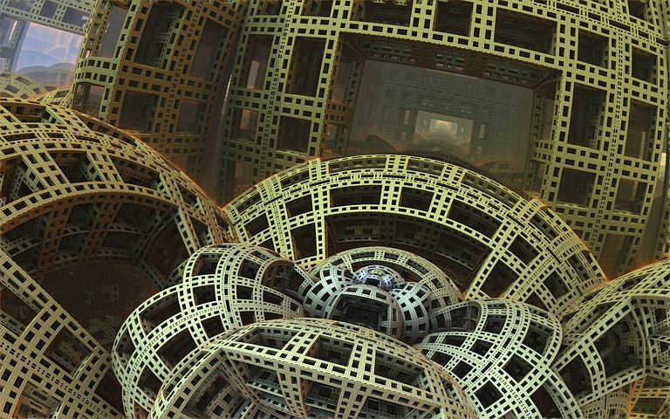
Proposal
Interactive learning in Augmented or Virtual reality
Permanent and encouraging assessment

Slide 4
Augmented reality
Integration of digital information with the user's environment in real time
Virtual reality
Artificial environment that is presented in a way that the user accepts as reality
Both provide
“Learning by doing” environment
Short learning curve (reported)

Slide 5
The Pokémon: AR – based game
User’s actual environment is augmented with digital characters

Slide 6
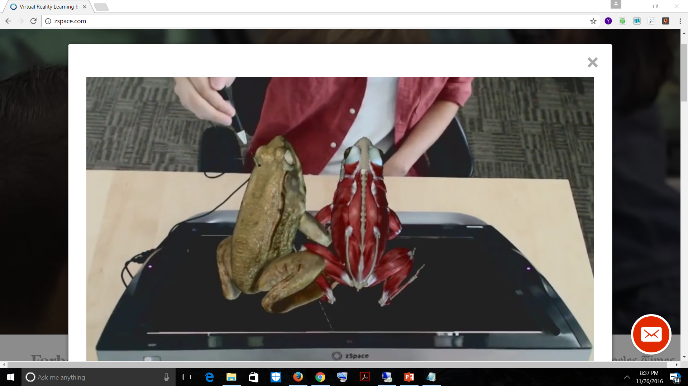
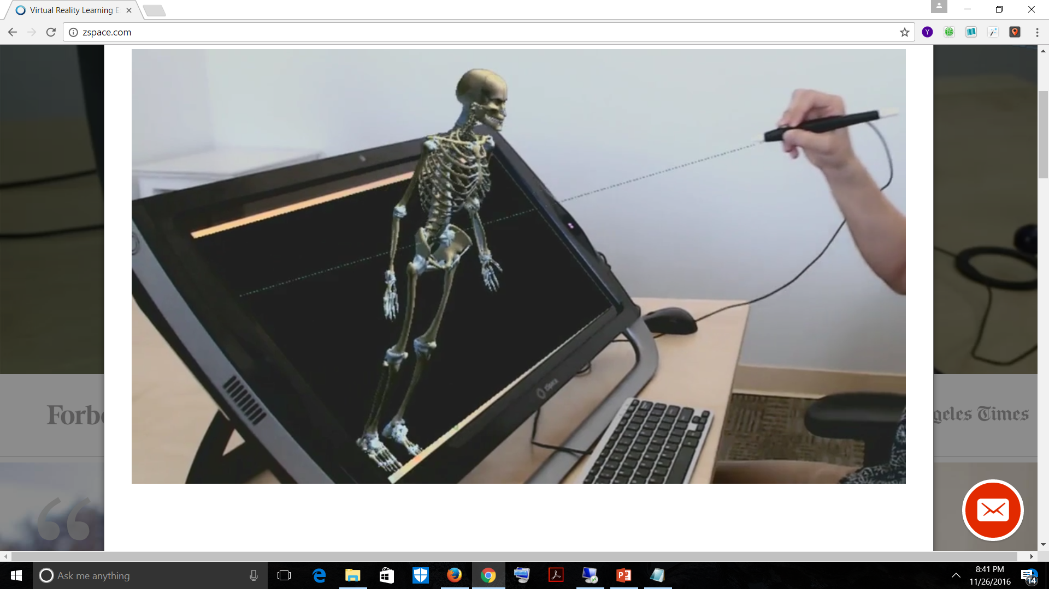
AR is currently applied in teaching biology and anatomy
Source: zspace.com

Slide 7
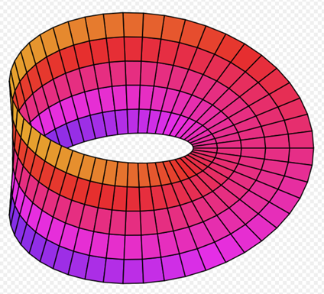
How to use AR in mathematics?
Counterintuitive mathematical objects
Example 1: Mobius strip – surface with one side and one boundary

Slide 8
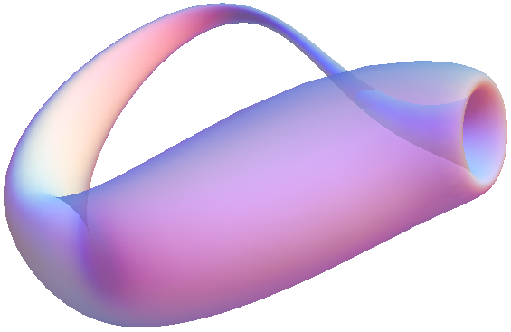
Example 2: Klein bottle - a non-orientable surface

Slide 9
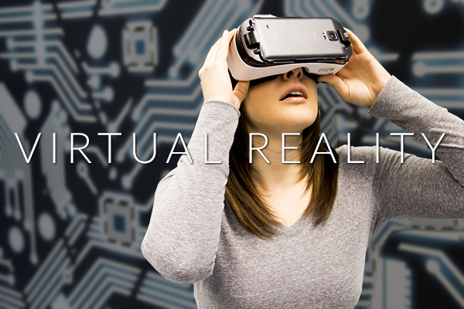
Virtual reality, in contrast to AR, provides complete immersion into a world designed to serve specific educational goals

Slide 10
VR is a computer game
Goggles
Hearables (smart headphones)
Sensors allowing to read voice, handwriting, body language
3D video
Stereo sound
Interactivity

Slide 11
This pair of images look like one 3D picture in VR goggles

Slide 12
Imitation of the steering wheel rotation ->> navigation of the virtual plane in VR

Slide 13
VR applied to Calculus
Limits
Continuity/discontinuity
Derivatives and tangent lines
Riemann sum and integration

Slide 14
Example: Skateboarding Environment
Source: www.youtube.com/watch?v=v2ptFfXcZ20
Standing on Skateboard + VR Goggles = full sense of skating
Continuity => Smooth skating
Jump discontinuity => a jump
Oscillations => skateboarding in a halfpipe
Tangent line => direction of a jump

Slide 15
Continuity => Smooth Skating

Slide 16
Discontinuity => a jump

Slide 17
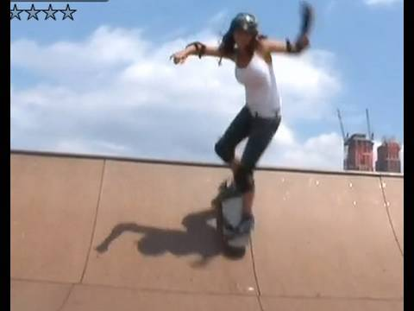
Oscillations => skateboarding in a halfpipe

Slide 18
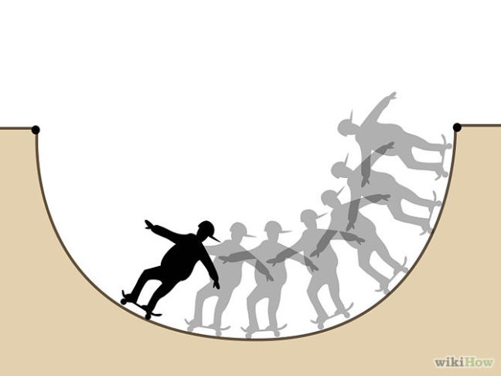
Oscillations with limit
Skateboarder stops at the lower level after several runs

Slide 19
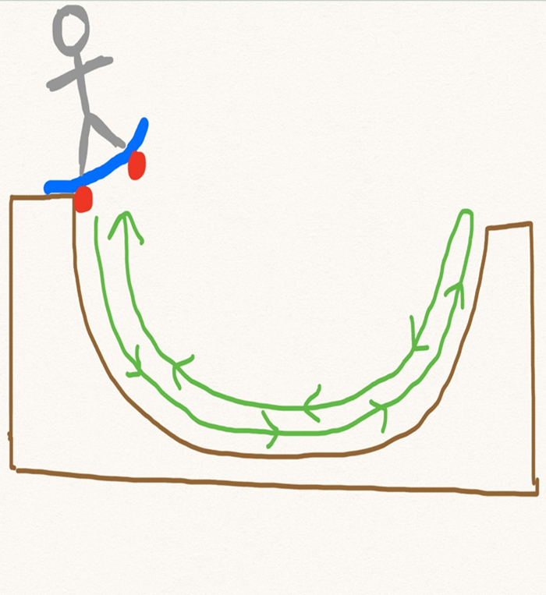
Oscillations with no limit
Skateboarder “oscillates” indefinitely

Slide 20
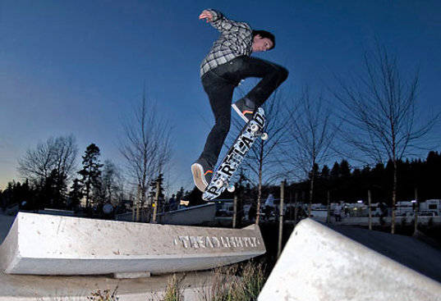
Tangent line
Direction of a jump for skateboarder

Slide 21
Another Example: Construction Environment
Riemann Sum =>> Student is a mason building a wall of predefined shape

Slide 22
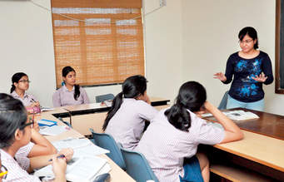
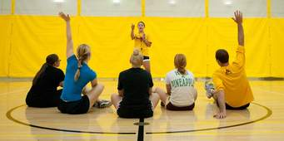
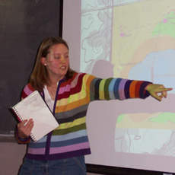
Virtual Reality learning environment may accommodate the personal preferences of the student

Slide 23
Different teaching techniques and learning styles
Group learning
Inquiry-based learning
Multiple intelligence
Research-based teaching
Visually-impaired or hearing-impaired students
Real-life examples www.internet2.edu/blogs/detail/10002

Slide 24
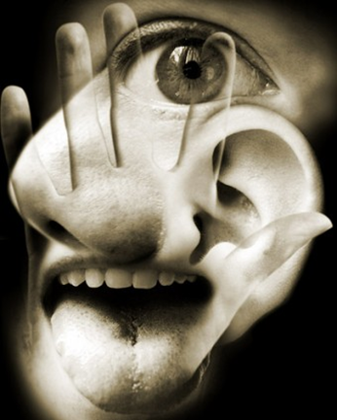
Potential Problems
Long Term Impact is not yet known
Educators and psychologists should work together to prevent unintended consequences
Impact on sight and hearing
Possible psychological impact
Change in social behavior
Uncontrolled use of technology
No established curriculum Source: www.todayifoundout.com/index.php/2010/07/humans-have-a-lot-more-than-five-senses/

Slide 25
Proposals
Form a research group of educators and psychologists
Organize a special interest group inside the AMS or MAA
Develop a network of educational institutions interested in AR/VR-based teaching
Find sources of financing

Slide 26
Thank you !
Questions?
avaninsky@hostos.cuny.edu

