Slide 1
Welcome!
Thank You for Joining Us
&
We’re Glad You are Here!

Slide 2
What’s Mine is YOURLS
Kimberly R. Abrams and Junior Tidal
New York City College of Technology, CUNY

Slide 3
Overview
What is YOURLS
Problems that YOURLS remedies
Cross Platform Compatibility
Usability and Accessibility
Marketability
Installation
How to use YOURLS
Workflow

Slide 4
What is YOURLS?
YOURLS is an open-source URL shortening service.

Slide 5
What is YOURLS?
YOURLS software is free.
Depending on your institution, the URL, server, and supporting software may not be.

Slide 6
What is YOURLS?
YOURLS uses plug-ins to extend functionality.

Slide 7
What is YOURLS?
For example, one plugin can import and export records stored in YOURLS.

Slide 8
Problems that YOURLS Remedies
Dead Links or “Link Rot”
Link Maintenance
Cross Platform Compatibility
Link Usability
Marketability

Slide 9
Avoiding link rot
When links go dead, websites no longer fulfill their basic function.
By using a short link manager, the short links redirect through the manager to the original URL.
As long as the long links are updated in YOURLS, there should not be dead links, because the short links do not change.

Slide 10
Traditional Model of Link Maintenance
URL Change
Add Proxy Prefix
Update Website
Update LibGuides
Update Social Media
http://search.ebscohost.com/login.aspx?authtype=ip,uid&profile=ehost&defaultdb=a9h
http://citytech.ezproxy.cuny.edu:2048/login?url=http://search.ebscohost.com/login.aspx?authtype=ip,uid&profile=ehost&defaultdb=a9h

Slide 11
YOURLS Model of Link Maintenance
URL Change
Add Proxy Prefix
Update Short Link in YOURLS
All instances of the short link will automatically redirect users to the new link.
http://search.ebscohost.com/login.aspx?authtype=ip,uid&profile=ehost&defaultdb=a9h
http://citytech.ezproxy.cuny.edu:2048/login?url=http://search.ebscohost.com/login.aspx?authtype=ip,uid&profile=ehost&defaultdb=a9h
http://cityte.ch/asc

Slide 12
Cross Platform Compatibility
Short links work across all the platforms that the library utilizes because it is linked through a third party server.
There is no need to update links on the various platforms, because they are all automatically redirected through YOURLS.

Slide 13
Usabililty and Accessibility
Short links are more memorable because they consist of fewer characters than the longer proxied links.
They are easier to enter on a mobile keyboard because they have fewer characters. This utility is especially useful if the characters are all lowercase.
More memorable and easier to type short links make the resource more accessible for the end user.

Slide 14
Marketability
Social Media
Blog
Digital Flyers
Print Flyers
Classroom handouts

Slide 18
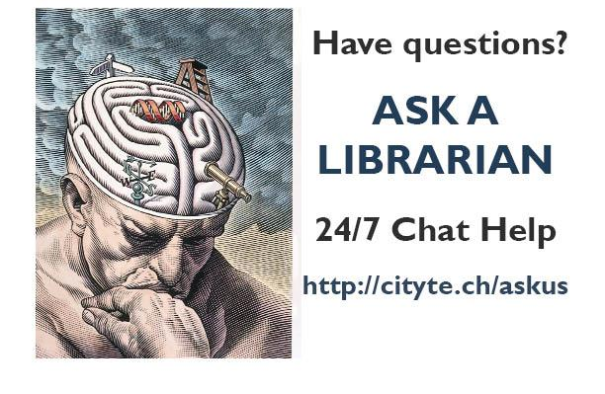

Slide 19
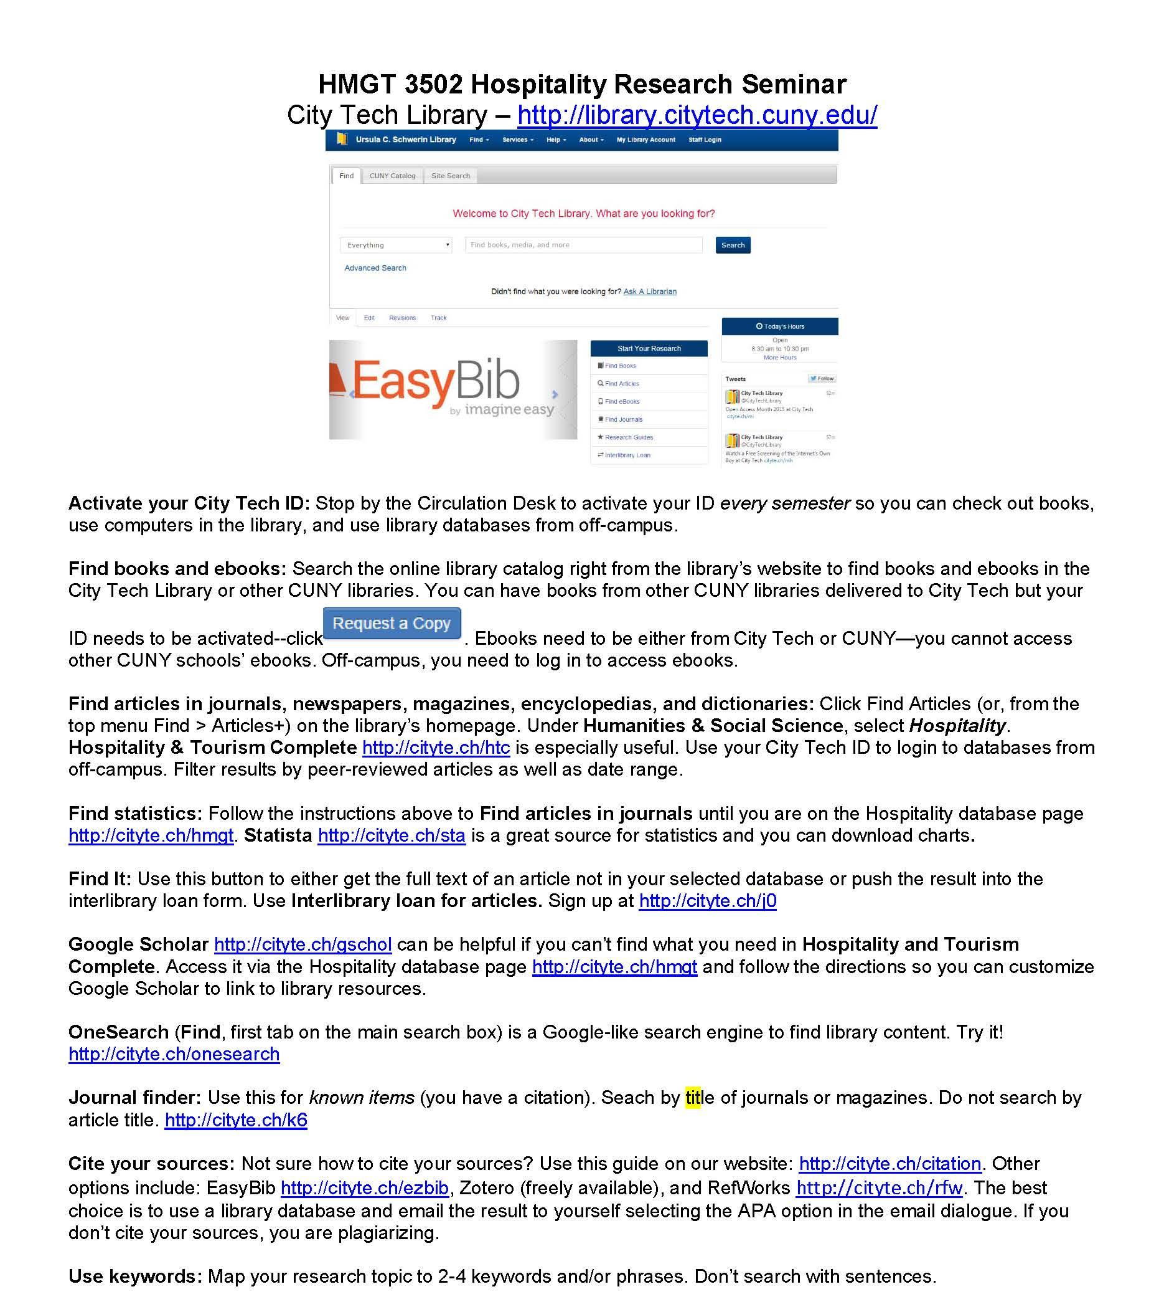

Slide 20
Statistics through YOURLS
YOURLS keeps track of how many clicks are made for each short URL.
Short URLS can be configured to track specific media.
Ex. http://cityte.ch/acsprint can be used to track a short link distributed through print materials.

Slide 21
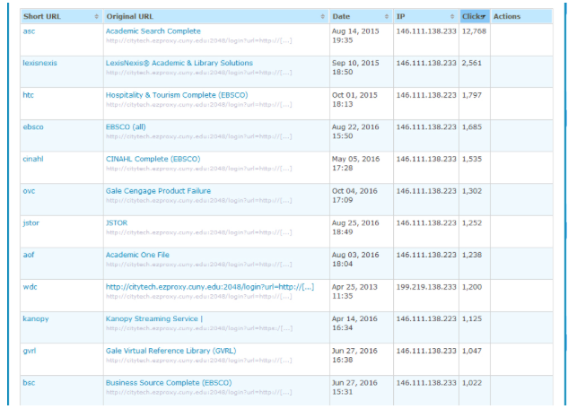
Statistics

Slide 22
Installing YOURLS
YOURLS requires some technical know-how to install and run

Slide 23
Installing YOURLS
There are a number of server requirements to install YOURLS.

Slide 24
Installing YOURLS
Requirements for YOURLS:
A domain cityte.ch
A server
Apache - web server software
MySQL - a database language
PHP - a web scripting language

Slide 25
Installing YOURLS
The web server should be running using the registered domain.

Slide 26
Installing YOURLS
The domain name should be short and memorable.

Slide 27
Installing YOURLS
The domain for this workshop is http://eld.party

Slide 28
Installing YOURLS
A MySQL server should be set up for YOURLS to use.

Slide 29
Installing YOURLS
The server contains records of the original URLs, short URLs, and statistics.

Slide 30
Installing YOURLS
The YOURLS installation packaged should be unarchived on the web server.

Slide 31
Installing YOURLS
YOURLS has a configuration file that needs to be edited with the MySQL server information.

Slide 32
How to Use YOURLS
Once the server is setup, users must be created to access the program.

Slide 33
How to Use YOURLS
YOURLS can now be used to shorten URLs.

Slide 34
Workflow for shortening and standardizing links
Shorten the proxied URL for the resource in YOURLS.
Use an acronym for the database that makes sense.
Use all lowercase letters or numbers

Slide 35
Workflow Continued
Enter the shortened URL into the e-resource content management pages in Drupal.
Drupal is an open source CMS that is used to make websites.

Slide 36
Workflow Continued
Upload the electronic resource metadata from Drupal into the A-Z Database Assets function in Libguides.
LibGuides is a proprietary resource that many libraries use to create and manage research guides.

Slide 37
Create Your Own Short Link
http://eld.party/admin
Username: demo
Password: demo
Login and create a short link for your institution.

Slide 38
Conclusion and Caveats
If the YOURLS server goes down, then all the links will go dead until the server is back up.
Back-up links using the plugin or another method.

Slide 39
Questions?

Slide 40
Thanks
Kimberly R. Abrams, kabrams@citytech.cuny.edu
Junior Tidal, jtidal@citytech.cuny.edu, @juniortidal

Slide 41
Session Evaluations Contest
https://tinyurl.com/OLCwELD-program
Navigate to specific session page to evaluate
Click orange “Evaluate Session” button on the right
Complete session evaluation*
Each session evaluation completed (limited to one per session) = one contest entry
One (1) $25 gift card will be awarded
*Contact information required for contest entry but will not be shared with the presenters. Winners will be contacted post-conference.

Slide 42
Follow Us on Twitter!
Let’s Get the trending
on Twitter!
@ELDconf
@OLCToday

