Slide 1
PROMOTING BANNED BOOKS IN THE CITY TECH LIBRARY
JUNIOR TIDAL WEB SERVICES & MULTIMEDIA LIBRARIAN
NEW YORK CITY COLLEGE OF TECHNOLOGY

Slide 2
OUTLINE
BACKGROUND ON CITY TECH
PROMOTING BANNED BOOKS IN THE COLLECTION
PHYSICAL PROMOTION
SOCIAL MEDIA PROMOTION
IMPACT OF PROMOTING BANNED BOOKS

Slide 3
BACKGROUND
NEW YORK CITY COLLEGE OF TECHNOLOGY

Slide 4
BACKGROUND
COLLOQUIALLY KNOWN AS CITY TECH

Slide 5
BACKGROUND
ONE OF 23 CAMPUSES OF THE CITY UNIVERSITY OF NEW YORK

Slide 6
BACKGROUND
LOCATED IN DOWNTOWN BROOKLYN

Slide 7
BACKGROUND
CONSIDERED A COMMUTER SCHOOL

Slide 8
BACKGROUND
OVER 17,000 STUDENTS

Slide 9
BACKGROUND
STUDENTS COME FROM ALL 5 BOROUGHS OF NYC AND NEW JERSEY

Slide 10
BACKGROUND
COME FROM DIVERSE BACKGROUNDS

Slide 11
BACKGROUND
35% ARE BORN OUTSIDE THE U.S.

Slide 12
BACKGROUND
73% SPEAK A LANGUAGE OTHER THAN ENGLISH AT HOME

Slide 13
BACKGROUND
61% REPORT A HOUSEHOLD INCOME LESS THAN $30K

Slide 14
BACKGROUND
OVER 83% OF STUDENTS SELF-IDENTIFY AS NON-WHITE.

Slide 15
PROMOTING BANNED BOOKS FROM THE COLLECTION
SOCIAL MEDIA
PHYSICAL PROMOTION
IMPACT OF PROMOTING BANNED BOOKS

Slide 16
PROMOTING BANNED BOOKS FROM THE COLLECTION
CITY TECH LIBRARY CELEBRATES BANNED BOOKS WEEK EVERY SEPTEMBER

Slide 17
PROMOTING BANNED BOOKS FROM THE COLLECTION
WE HAVE BEEN DOING THIS FOR THE LAST 10 YEARS

Slide 18
PROMOTING BANNED BOOKS FROM THE COLLECTION
LED BY THE INTERNAL PUBLIC RELATIONS, OUTREACH, AND MARKETING (PROM) COMMITTEE

Slide 19
PROMOTING BANNED BOOKS FROM THE COLLECTION
PROM USES A VARIETY OF PROMOTION EFFORTS

Slide 20
SOCIAL MEDIA
POSTS TO LIBRARYBUZZ, OUR LIBRARY BLOG
HTTPS://LIBRARY.CITYTECH.CUNY.EDU/BLOG

Slide 21
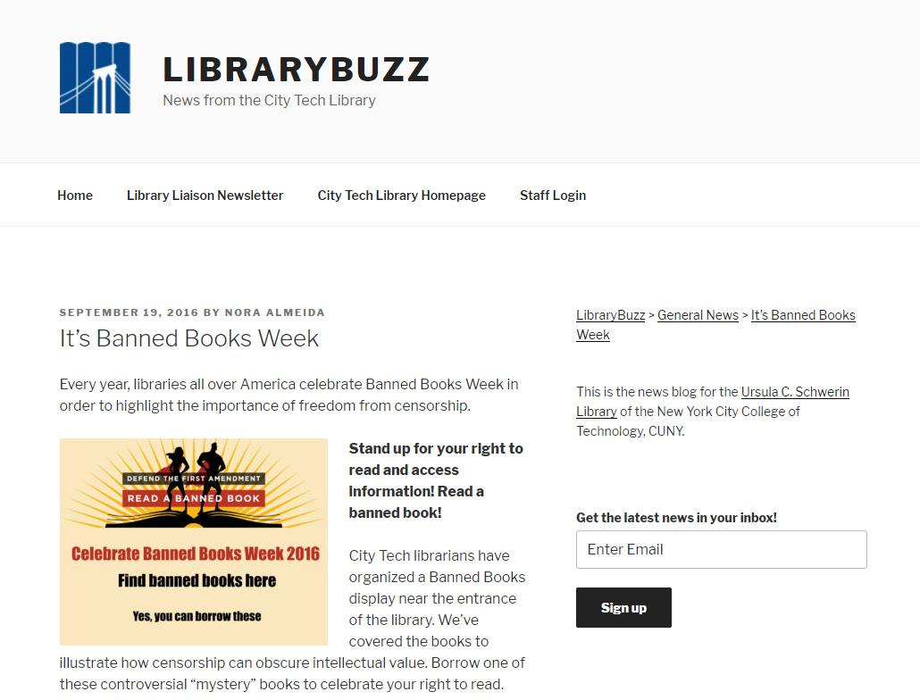

Slide 22
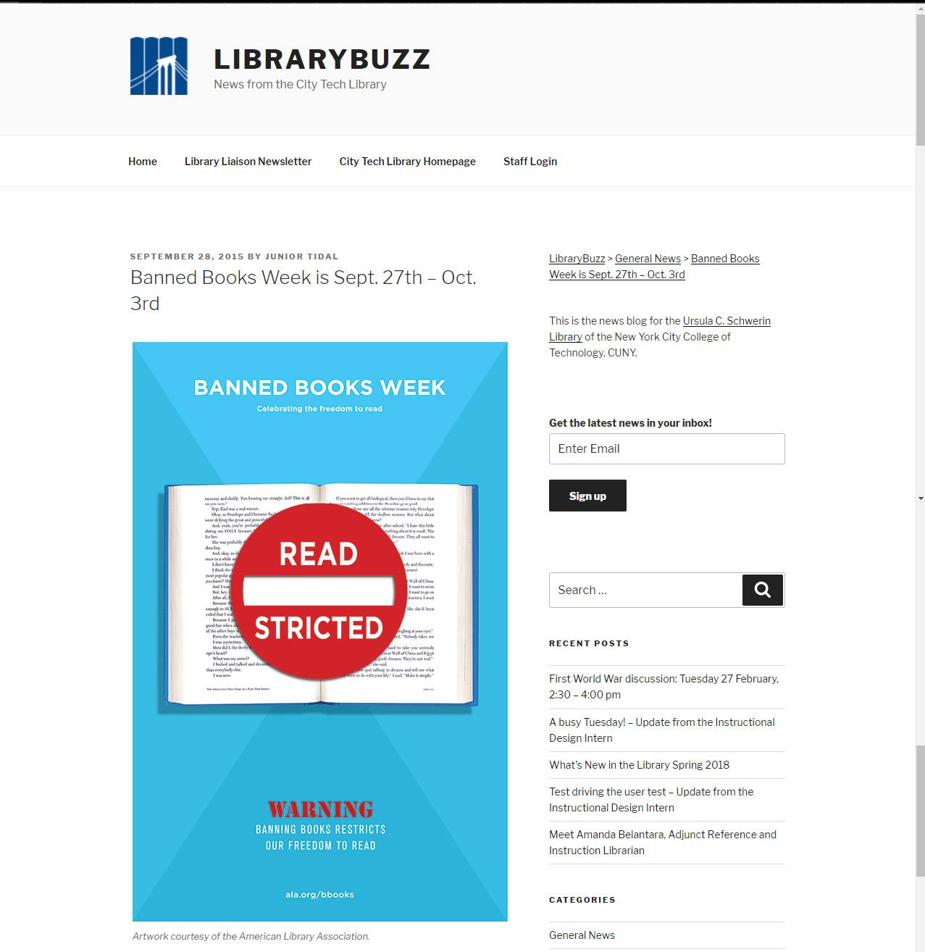

Slide 23
SOCIAL MEDIA
IFTTT.COM - IF THIS THEN THAT IS A WEBSITE THAT TRIGGERS OTHER SOCIAL MEDIA SITES DEPENDING ON CERTAIN CONDITIONS

Slide 24
SOCIAL MEDIA
THE POST TO THE BLOG IS THE TRIGGER ACTIVATING SOCIAL MEDIA PLATFORMS

Slide 25
SOCIAL MEDIA
TWITTER AND FACEBOOK ARE AUTOMATICALLY UPDATED USING IFTTT.COM

Slide 26
SOCIAL MEDIA
TWITTER AND FACEBOOK HEADERS USE BANNERS PROVIDED FROM ALA

Slide 27
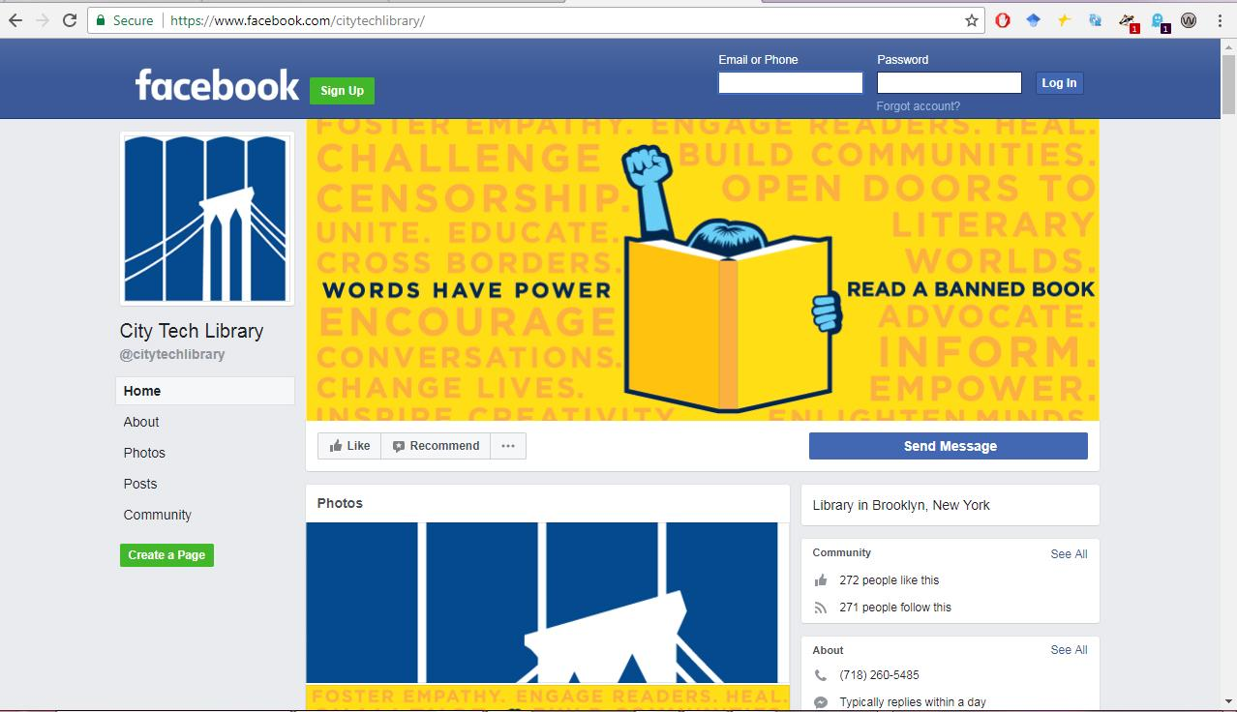

Slide 28
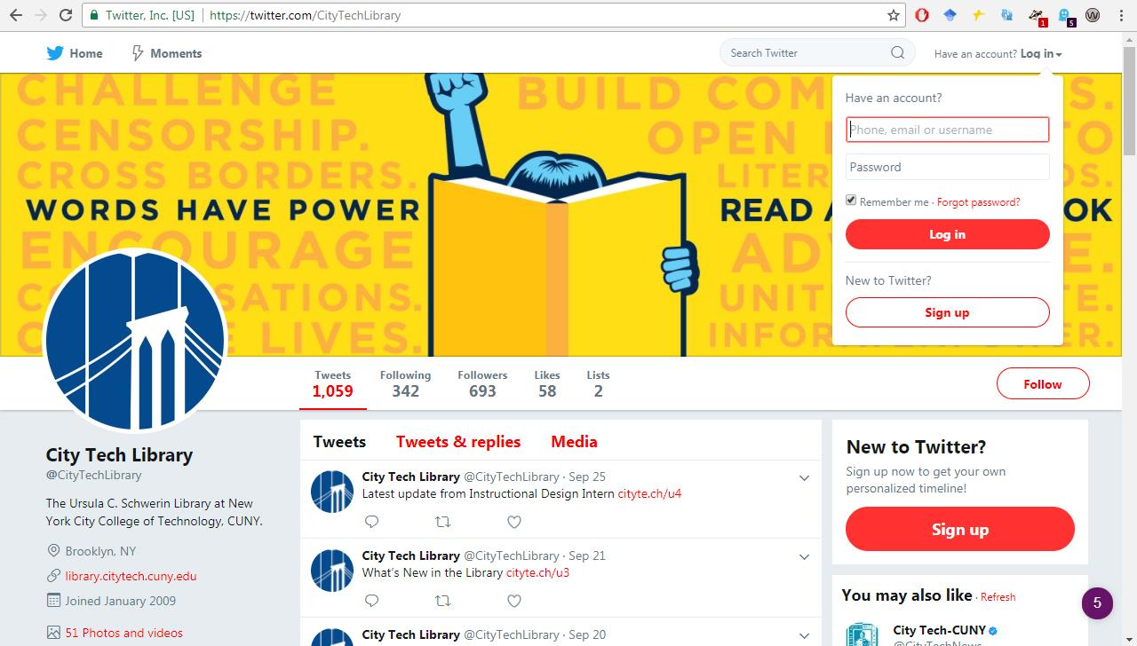

Slide 29
SOCIAL MEDIA
WE ALSO POST PHOTOS OF OUR DISPLAYS ON INSTAGRAM

Slide 30
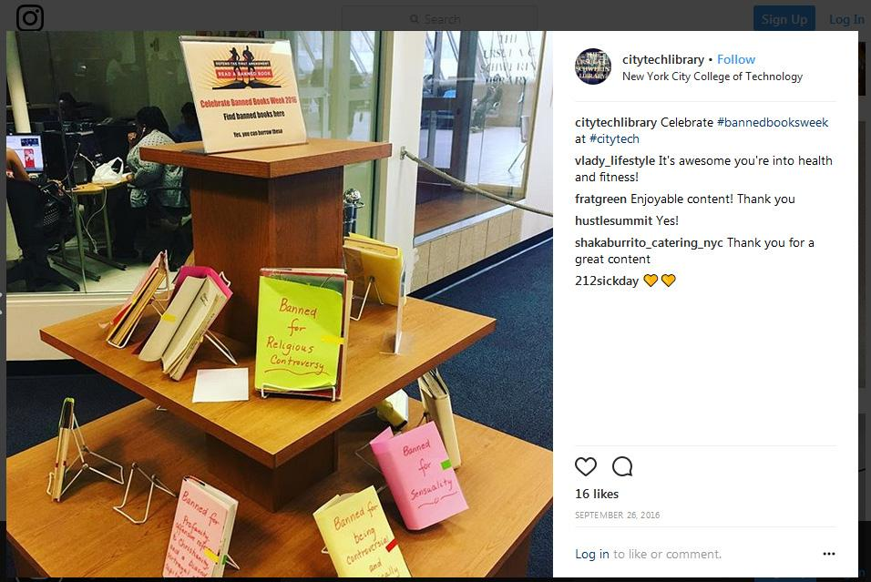

Slide 31
PHYSICAL PROMOTION

Slide 32
PHYSICAL PROMOTION
WE USED A BOOK DISPLAY TO HIDE BOOK COVERS.

Slide 33
PHYSICAL PROMOTION
WORKFLOW CONSISTS OF DEVELOPING A LIST OF BANNED BOOKS

Slide 34
PHYSICAL PROMOTION
COLLEGE ASSISTANTS, STAFF, AND LIBRARIANS PULL BOOKS FROM THE STACKS

Slide 35
PHYSICAL PROMOTION
BOOKS ARE GIVEN TO TECHNICAL SERVICES DEPARTMENT FOR “PROCESSING.”

Slide 36
PHYSICAL PROMOTION
BOOK COVERS ARE WRAPPED

Slide 37
PHYSICAL PROMOTION
REASONS WHY THE BOOK WAS BANNED IS WRITTEN ON THE BOOK COVER

Slide 38
PHYSICAL PROMOTION
IN THE PAST WE ALSO HELD SCREENINGS OF FILMS BASED ON BANNED BOOKS

Slide 39
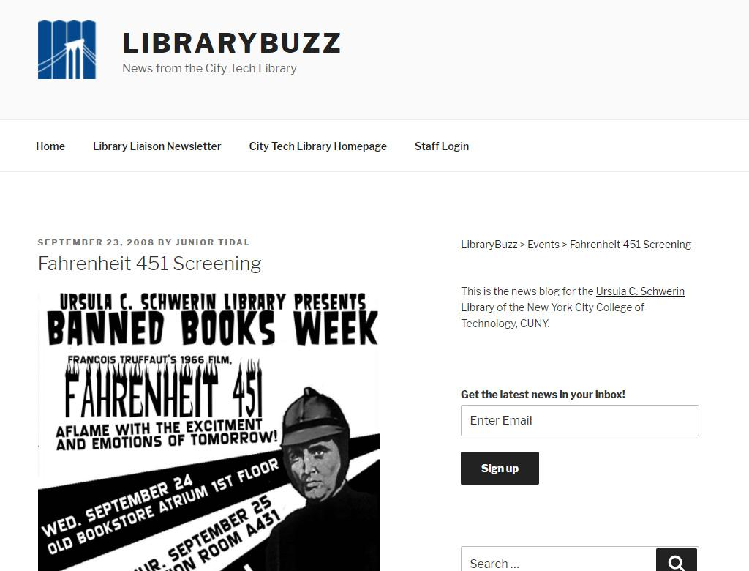

Slide 40
IMPACT OF PROMOTING BANNED BOOKS

Slide 41
IMPACT OF PROMOTING BANNED BOOKS
THERE’S NO FORMAL WAY TO SEE IF BANNED BOOKS WERE CHECKED OUT

Slide 42
IMPACT OF PROMOTING BANNED BOOKS
MOST BOOKS CHECKED OUT FROM THE DISPLAY

Slide 43
IMPACT OF PROMOTING BANNED BOOKS
THIS HAS BEEN CONSISTENT YEAR TO YEAR

Slide 44
IMPACT OF PROMOTING BANNED BOOKS
UNFORTUNATELY, THERE IS A LACK OF ATTENDANCE FOR SCREENINGS

Slide 45
IMPACT OF PROMOTING BANNED BOOKS
CITY TECH IS A COMMUTER SCHOOL

Slide 46
IMPACT OF PROMOTING BANNED BOOKS
LIBRARIANS FEEL THAT IT’S IMPORTANT TO CELEBRATE BANNED BOOKS

Slide 47
IMPACT OF PROMOTING BANNED BOOKS
ACCORDING TO THOMPSON, BANNING BOOKS ENFORCES A PARTICULAR WORLDVIEW OR SET OF BELIEFS (2016).
Thompson, Z. (2016, September 29). You should be reading banned books - #BannedBooksWeek [Blog post]. Retrieved from https://www.huffingtonpost.com/zac-thompson/you-should-be-reading-banned-books_b_12253240.html

Slide 48
IMPACT OF PROMOTING BANNED BOOKS
EXPOSING STUDENTS TO BANNED BOOKS AND WHY THEY WERE BANNED IS A PRACTICE OF INCLUSIVE LIBRARIANSHIP.

Slide 49
IMPACT OF PROMOTING BANNED BOOKS
BOOKS BANNED BECAUSE OF CONTROVERSIAL VIEWS ON RACE:
THE AUTOBIOGRAPHY OF MALCOLM X
THE ADVENTURES OF HUCKLEBERRY FINN
INVISIBLE MAN

Slide 50
IMPACT OF PROMOTING BANNED BOOKS
PROMOTING SERVICES RICH IN DIVERSITY MAY REFLECT AN INCLUSIVE LIBRARY SPACE OF RACIAL EQUITY

Slide 51
IMPACT OF PROMOTING BANNED BOOKS
“...inclusive libraries, diverse books are promoted year round” (Stivers & Hughes-Hassell, 2015)
Strivers, J and Hughes-Hassell, S. (2015, March 7). #act4teens: The inclusive library: More than a diverse collection: Part 1. Retrieved from http://yalsa.ala.org/blog/2015/03/07/act4teens-the-inclusive-library-more-than-a-diverse-collection-part-1/

Slide 52
IMPACT OF PROMOTING BANNED BOOKS
CELEBRATING BANNED BOOKS WEEK COULD BE THE CATALYST TO PROMOTE DIVERSE PROGRAMS, RESOURCES, AND COLLECTIONS.

Slide 53
WRAPPING UP
BACKGROUND ON CITY TECH
PROMOTING BANNED BOOKS IN THE COLLECTION
PHYSICAL PROMOTION
SOCIAL MEDIA PROMOTION
IMPACT OF PROMOTING BANNED BOOKS

Slide 54
QUESTIONS?

Slide 55
THANKS!

