Slide 1
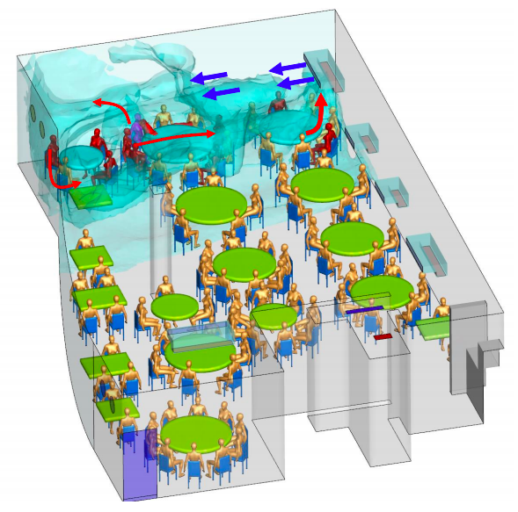
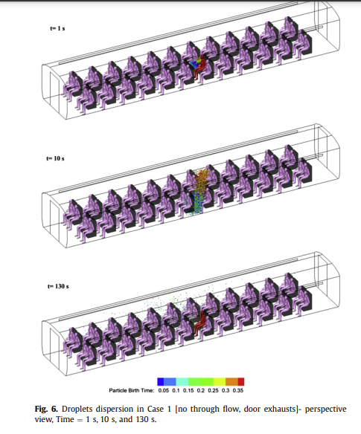
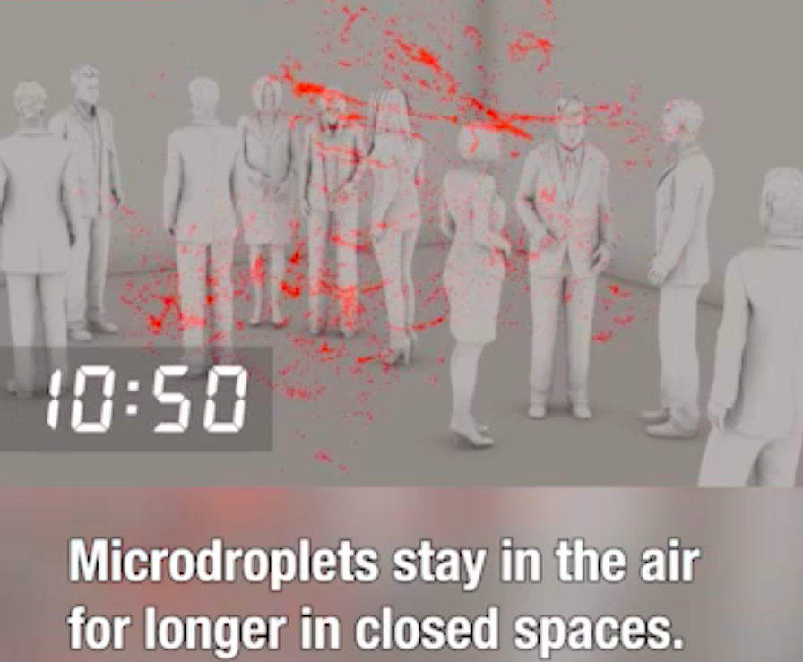
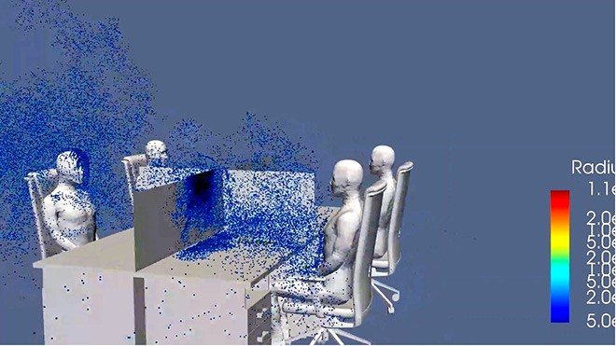
UNDERSTANDING OF AEROSOL TRANSMISSION OF COVID-19 IN INDOOR ENVIRONMENTS
Adama Barro, Cathal O’Toole, Jacob S. Lopez, Matthew Quinones, and Sherene D. Moore
Mentor: Professor Daeho Kang
New York City College of Technology, CUNY
ABSTRACT
METHODS
RESULTS
The focus is to discuss the research on aerosol transmission characteristics of severe acute respiratory syndrome novel coronavirus (Covid-19), in poorly ventilated indoor spaces, and to mitigate further spread of this disease by designing a new HVAC system. The purpose: eradicate the spread of this virus by testing poorly ventilated occupied areas in facilities, further understand the effectiveness of mechanical ventilation controls. We believe that scientists and engineers have not yet invented an aeration approach to specifically combat Covid-19 in the indoor environments. The goal is to answer this need and construct an innovative HVAC model, with highly efficient filtration and ventilation components, by conducting an epidemiological investigation researching pre-symptomatic, symptomatic, and asymptomatic individuals; case studies and scientific results of COVID-19 pathogen fluid dynamics in enclosed spaces.
First, articles on experimental tracer gas measurements using computational fluid dynamics software were examined.
Second, numerical simulation results mimicking the behavior of cough droplets in enclosed spaces with two individuals standing at fixed distances from each other were also examined.
Third, research methods used to assess the different characteristics of Covid-19 and various other infectious aerosols pertaining to particle sizes, aerodynamics, concentrations, infectivity, and virulence were reviewed.
Fourth, we considered a realistic geometry and ventilation system, in order to study how the coughed droplets disperse.
Fifth, an epidemiologic investigation on a Korean call center in “Building X” was conducted using contact tracing, collected medical reports & data from the South Korean government, Korean Center for Disease Control & Prevention (SKCDC), and South Korea’s national level health authority.
There was insufficient aeration; concentration of viral airborne pathogens depends on the source strength and ventilation rate.
The results of the numerical simulation illustrates that close proximity between persons in enclosed spaces can cause a higher infection rate. Also, using displacement ventilation discharges coughed droplets easier than mixing air ventilation.
With a total volume of 15,200 cubic feet and an average occupancy of 89 people, the air exchange rate found would equate to an outdoor air supply of 1.04 liters per second and 0.75 liters per second per person.
The droplet dispersion process after one single cough by an individual is demonstrated by plotting the locations of all airborne droplets in perspective view, side view and top view.
Although laboratory engineering control tests have been conducted, they must be applied to an actual indoor environment with a nonpathogenic microorganism, to examine the success.
Building X”: “Most of the case-patients on the 11th floor were on the same side of the building. Among the 97 confirmed case-patients, 89 (91.7%) were symptomatic at the time of investigation and 4 (4.1%) were presymptomatic during the time of investigation but later had onset of symptoms within 14 days of monitoring; 4 (4.1%) case-patients remained asymptomatic after 14 days of isolation.
DISCUSSION
Displacement air ventilation and the use of HEPA filters could be a viable source in diminishing the spread Covid-19, by removing cough droplets in enclosed spaces. The outbreak cannot be explained by droplet transmission alone, as the aerosols are prompted by the direction of the airflow. Coughing and airflow direction impacts dispersion of pathogens.
REFERENCES
Figure 1. CFD study on airflow in a restaurant.
Adapted from reference #5.
1. Cole, DrPH, E. C., &amp; Cook, MS, C. E. (1998). Characterization of infectious aerosols in health care facilities: An aid to effective engineering controls and preventive strategies. Durham, N.C.: The Association for Professionals in Infection Control and Epidemiology.
2. Broom, Douglas S. (2020, April 14). This Japanese experiment shows how easily coronavirus can spread – and what you can do about it. Retrieved November 26, 2020 (adapted from O’Toole et al, 2020).
3. Fears, A., Klimstra, W., Duprex, D., Hartman, A., Weaver, S., Plane, K., Roy, C. (2020). Comparative dynamic aerosol efficiencies of three emergent coronaviruses and the unusual persistence of SARS-CoV-2 in aerosol suspensions. MedRxiv.
4. Kang, Z., Zhang, Y., Fan, H., & Feng, G. (2015). Numerical Simulation of Coughed Droplets in the Air-Conditioning Room. Elsevier Ltd.
5. Li, Y., Qian, H., Hang, J., Chen, X., Hong, L., Liang, P., Kang, M. (2020). Evidence for probable aerosol transmission of SARS-CoV-2 in a poorly ventilated restaurant. Retrieved November 24, 2020, https://www.medrxiv.org/content/10.1101/2020.04.16.20067728v1
6. Park, S., Kim, Y., Yi, S., Lee, S., Na, B., Kim, C., Jeong, E. (2020). Coronavirus Disease Outbreak in Call Center, South Korea. Atlanta, GA.: www.cdc.gov/eid, Emerging Infectious Diseases, Vol. 26.
7. Zhang, L., & amp; Yuguo, L. (2012). Dispersion of Coughed Droplets in a Fully Occupied High Speed Rail Cabin. China: Department of Mechanical Engineering, The University of Hong Kong.
Fig 2. Computer simulation of the dispersed droplets in an office
Adapted from reference #6.
Fig 3. Experiment on microdroplets’ trajectory in the air
Adapted from reference #2.
Fig. 4. Dispersion of coughed droplets in a fully occupied high speed rail cabin
Adapted from reference #7.

