Slide 1

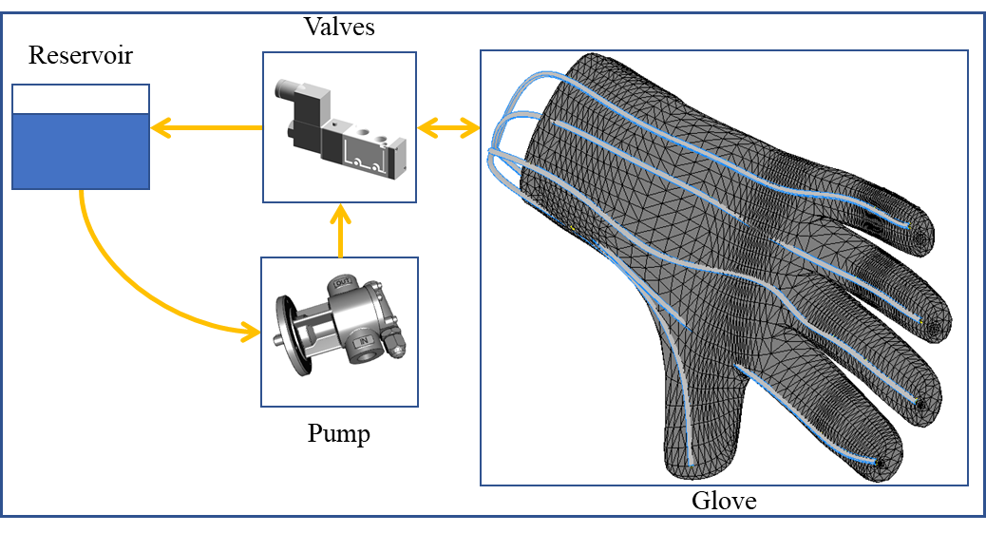
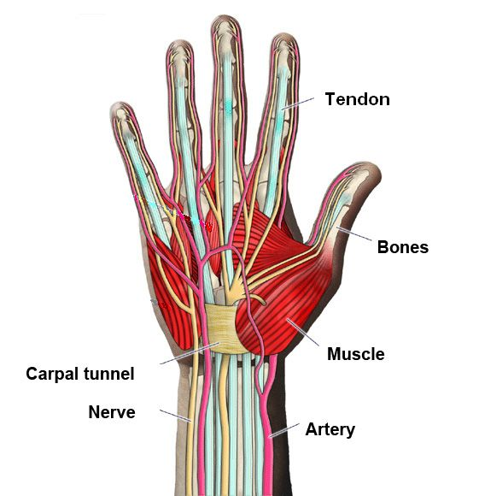
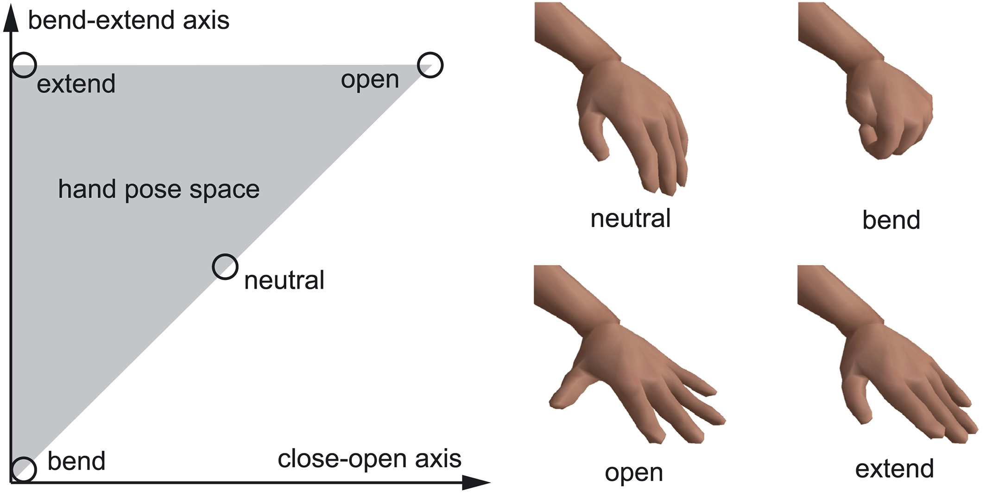
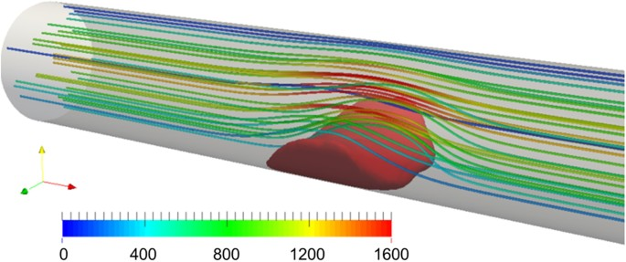
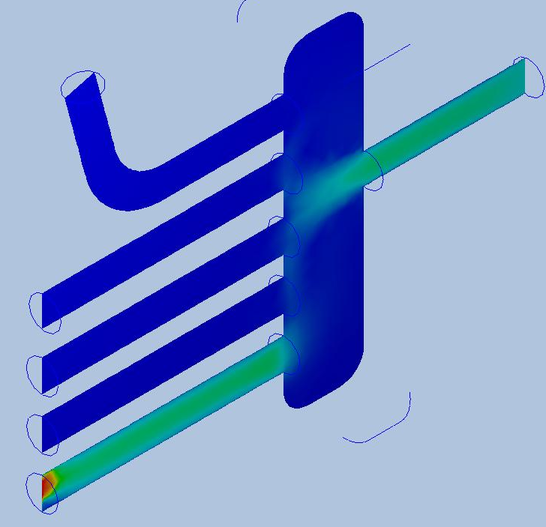
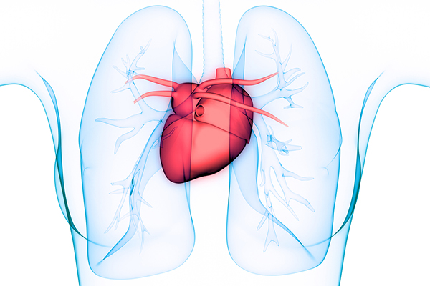

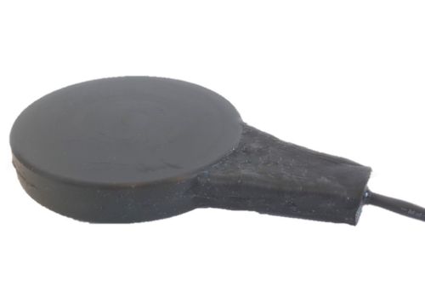
Force-feedback Design for Robotics Hand: Bio-based Design and Simulation
Student: Husnain Khan, Mentor: Zhou Zhang, Ph.D.
\
New York City College of Technology
Department of Mechanical Engineering Technology
Abstract:
Advantage:
Disadvantages
The great challenge for the Virtual Assembly Platform is how to make the users have the in-person feeling with the augmented tools. Hands are the most important organs that are used to provide touch feeling. In a real assembly scenario, the force from the components and tools will be feedback to the brain via the hands. Unfortunately, the virtual assembly failed to mimic the in-person scenarios since it will not provide such kind of feedback. As a result, the users’ real identities are lost. Then, the users’ slower-progressing wrong habits will prevent them from success in the future. Therefore, it is necessary to design a robotics hand that can provide force feedback. The proposed robotics hand will combine the motion synthesis of the human body, kinematic, dynamics, and computer graphics to reproduce the movement of a hand. Besides, spring, damper, and servo motors are integrated into the hand design. All the components will contribute to the force-feedback. After that, this project will be integrated into the project of “Procedure-Oriented for Engineering Education” to improve users ‘immersive feeling when they implement the virtual assembly.
Among the products and research, two methos are employed to provide the force feedback: passive and active actuation. Passive ones19 generate resistance with the dampers, springs, or electromagnetic clutches, and they are inherently safe since the resistance is one kind of reactions of the inertia system, and only effect when the motions detected. The active ones21 usually use motors and pneumatic systems to realize force-feedback. Its advantage is the force can adapt the changes of the motion to provide a more realistic feeling. The disadvantage will be the potential risk due to the malfunctional motions. Therefore, the specific design to safety is critical for the active haptic gloves: limit the maximum output loading, and design the emergency stop equipment. The proposed design can solve the conflict and provide an optimized trad-off between safety and force-feedback.
Bio-inspired design needs to employ the motion synthesis to figure out the relation between the hand motion and force generated according to the motion. It means that the complicated non-linear problems are involved. As a result, the complexity and the cost of computation will be a great burden for the research.
Applications:
The success of this project will benefit a diverse application as virtual rehabilitation, virtual training, virtual assembly, gaming, prothesis, dynamics analysis of fluid etc.
Conclusion:
In this project, a force-feedback hand is designed. It is inspired by the real hand, and simulated with Autodesk CFD. This project has the potential to provide the users with an immersive feeling when they use the virtual reality systems. After the simulation and design, the hand will be fabricated with additive manufacturing. To mimic the real hand, the filament of the 3D printer will use thermoplastic elastomers (TPE) that is flexible enough to make the hand.
Blood pressure in vessels
Motion synthesis of hand
Tentative Simulation:
Heart
Brain
Sensors
Hydraulic Control for Force-feedback
The pipes inside of the glove mimicking the vessels of the hand are powered by the hydraulic control system and used to generate the appropriate force based on the operations to the machines. It can spontaneously invoke the feeling of real operations to the various machines, and provide the users with an immersive virtual environment.
Bio-inspired Design of Hand
The procedures that the hand generates the force feedback are dementated: the hand is motivated, the sensors (nerves) detect the actions, the brain will process the data, and control the heart to power the vessels of the hand.
Distribution of Pressure in Pipes

