Slide 1
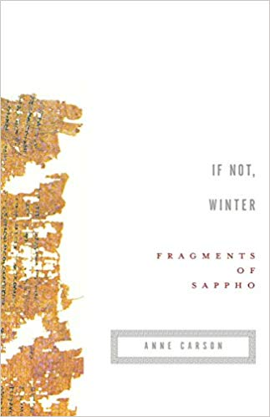
Great Books: Teaching Anne Carson’s Translation of Sappho
If Not, Winter
Fragments of Sappho
Anne Carson
Alison Cimino, M.F.A.

Slide 2
Ψαπφοι—Psappho, in English…Sappho
(Woman with wax tablets and stylus so-called "Sappho")

Slide 3
About Sappho
Born around 615 B.C
Died sometime around 550 B.C.
Lived on the island of Lesbos, in a town called Mytilene, just off the west coast of Turkey (before Socrates and Aristotle)
Called by Plato the 10th Muse
(Sappho portrays her staring rapturously at her contemporary Alcaeus)

Slide 4
About Sappho (Continued)
Her poems were first collected into nine volumes around the third century B.C., but her work was lost almost entirely for many years. Three centuries after her death the writers of the New Comedy parodied Sappho as both overly promiscuous and lesbian. This characterization held fast, so much so that the very term "lesbian" is derived from the name of her home island. Her reputation for licentiousness would cause Pope Gregory to burn her work in 1073. Poets.org
(Greek coin AEOLIS, KYME.)

Slide 5
In the If Not, Winter introduction Carson writes,
“On papyrus roll the text is written in columns, without word division, punctuation or lineation. To read such a text is hard even when it comes to us in its entirety and most papyri don’t. Of the nine books of lyrics that Sappho is said to have composed, one poem has survived complete. All the rest are fragments” (ix).
“Biographical sources mention a mother, a father, a daughter, a husband and three brothers of Sappho. She appears to have devoted her life to composing songs; scholars in Alexandria collected them in nine books, of which the first book alone had 1320 lines. Most of this is lost” (ix).

Slide 6
In the If Not, Winter introduction Carson writes,
“Controversies about her personal ethics and way of life have taken up a lot of people’s time throughout the history of Sapphic scholarship. It seems that she knew and loved women as deeply as she did music. Can we leave the matter there? As Gertrude Stein says,
She ought to be a very happy woman. Now we are able to recognize a photograph. We are able to get what we want. (‘Marry Nettie,” Gertrude Stein Writings 461)”

Slide 7
In John D’Agata’s Review of Carson’s book, “Stripped Down Sappho” he cites her introduction to discuss the use of brackets in her translation…
“I emphasize the distinction between brackets and no brackets because it will affect your reading experience, if you allow it. Brackets are exciting. Even though you are approaching Sappho in translation, that is no reason you should miss the drama of trying to read a papyrus torn in half or riddled with holes or smaller than a postage stamp—brackets imply a free space of imaginal adventure.”
D’Agata writes, Think of Carson’s brackets in If Not, Winter as a free space of lyricaladventure and the translation becomes immediately less a document of broken texts than an experiment in trust and imagination, as if each bracket were a flag that Carson was raising to signal us to run up and take over the baton. In her decision to give us less in her translation of Sappho, Carson has actually made the text ultimately more generous, and in this way has granted readers the pleasure of imagining their own versions of Sappho.

Slide 8
Photo of Sappho’s poem written on papyrus, demonstrating the missing text and challenge of translating Sappho.

Slide 9
Sappho’s Original Poem, 147 and Translated
μνάσασθαί τινά φαιμι †καὶ ἕτερον† ἀμμέων
I think men will remember us even hereafter. (Cox) (Also translated by Powell) Source: Dio Chrysostom, writing about A.D. 100.

Slide 10
If Not, Winter by Sappho tr. Anne Carson
147
Someone will remember us
I say
even in
another time

Slide 11
In his review, “Stripped Down Sappho,” D’Agata writes:
Should the fragments be reconstructed? Or should the fragments be left alone? Compare Carson’s uncommonly faithful translation of the four spare words comprising Sappho’s fragment 145—
do not move stones
—with the poet Mary Barnard’s version of the same four words in her 1958 best-selling collection entitled Sappho: A New Translation:
if you are squeamish don’t prod the beach rubble

Slide 12
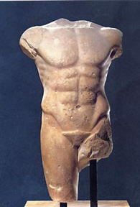
In “Disruption, Hesitation, Silence,” from Proofs and Theories, poet Louise Gluck discusses the power of fragments and silence in poetry, using Rilke’s ”Archaic Torso of Apollo” as an example:
“It seems to me that what is wanted, in art, is to harness the power of the unfinished. All earthly experience is partial. Not simply because it is subjective, but because that which we do not know, of the universe, of mortality, is so much more vast than that which we do know. What is unfinished or has been destroyed participates in these mysteries. The problem is to make a whole that does not forfeit this power” (74).
Click here for a link to Rilke’s poem: https://poets.org/poem/archaic-torso-apollo

Slide 13
“Disruption, Hesitation, Silence,” from Proofs and Theories, by Louise Gluck
“What wholeness gives up is the dynamic: the mind need not rush in to fill a void…In the broken thing, moreover, human agency is oddly implied: breakage, whatever its cause, is the dark complement to the act of making; the one implies the other. The thing that is broken has particular authority over the act of change” (75).

Slide 14
Lyric Poetry Exercises
Bring in a small object that fits in the palm of your hand. A pebble or shell works well with the exercise, but so do buttons, paperclips, or item you have in your belongings. (The exercise can also be done with your own non-writing hand.)
Take a few moments to hold the object and look at it, as if looking at it for the first time.
Take notes on the “object”
Write a poem about the object—follow the thread from your notes to the poem
For Lyric variation, choose an emotion and describe the object with that emotion in mind. Use the concrete object to represent the abstract emotion (like love, sadness, fear, or joy)

Slide 15
Fragment exercise with Space and Silence
Now cut two - three lines from your object exercise poem.
Do one of the following:
Reorder the poem without these lines OR
Pull these three lines and start a brand new poem.

Slide 16
Additional Poetry Exercise to use with Carson’s Sappho
Pull a line or a poem from If Not, Winter and use it as the starting line for your own poem. Write a poem from there.
If you are stuck you may flip through the book and pull five additional words to add to your own poem.

Slide 17
Making Connections to the 2020 Common Read
Explore myth and legend and write your own legend or quest story
Imagine you find the papyrus for a myth that is missing words or pages. Re-write your myth with your own imagined details.
Pull five lines from The Alchemist and write your own poem incorporating these lines
Print or photo copy one page from The Alchemist and create an erasure poem by blocking out all but the words for your poem.

